Slide 1
Intelligent Futures in
Task Assistance
Ryen W. White
General Manager and Deputy Lab Director
Microsoft Research in Redmond
ryenw@microsoft.com

Slide 2
Thank You
Thank you to my nomination team for all the support
Thank you to UKeIG for the award
Congratulations to Iadh on this well-deserved recognition

Slide 3
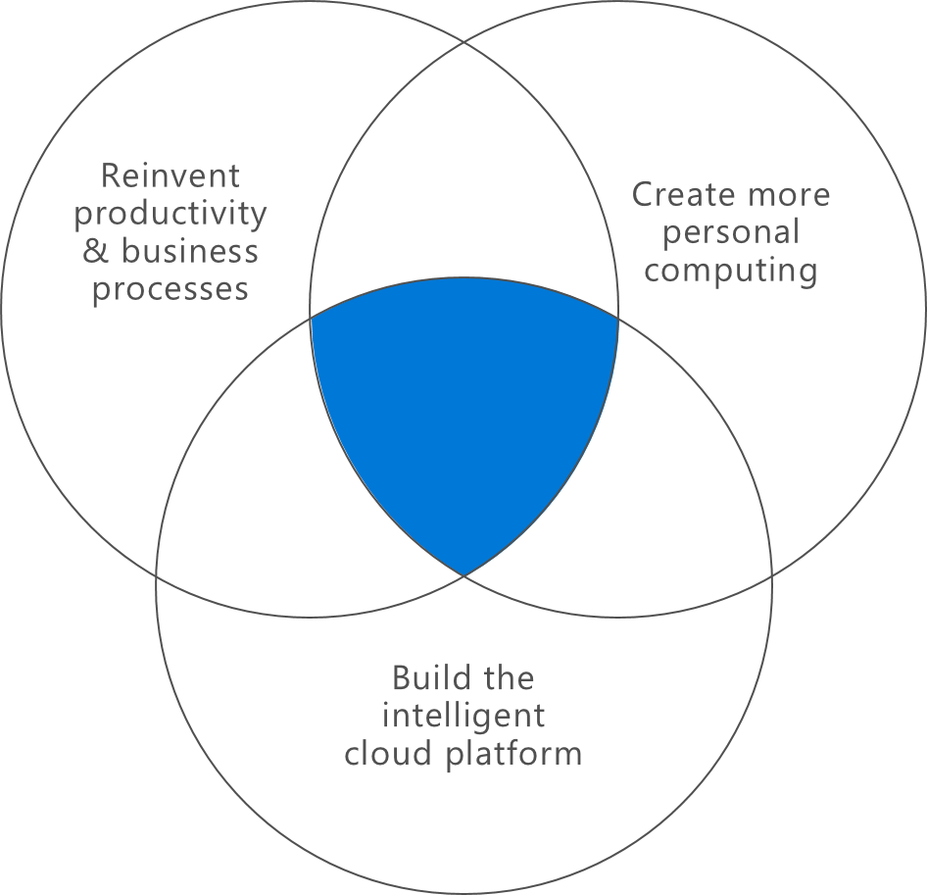
Microsoft Research
Established 1991
Ten labs, Eight locations
Including two cross-geo labs: AI4Science, Health Futures
Over 1000 scientists and engineers
Turing Award winners, Fields Medal winners, MacArthur Fellows,
Dijkstra Prize winners

Slide 4

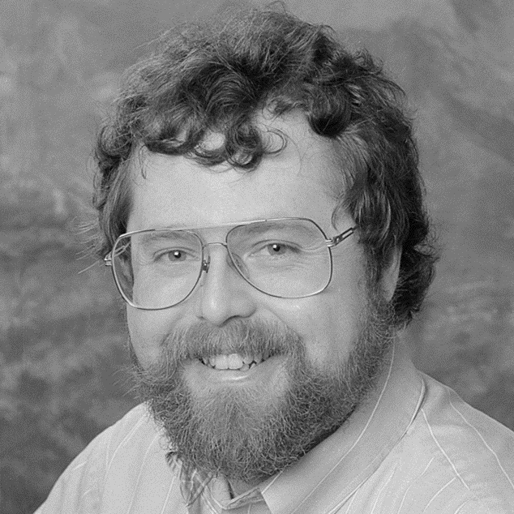
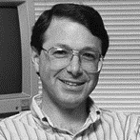

Across the World
1990
CTO Nathan Myhrvold writes memo
to Gates and Ballmer about need for fundamental computer research
Nathan Myhrvold
Cambridge
Redmond
Montreal
September 1991
His dream becomes a reality:
Rick Rashid leaves Carnegie Mellon University to lead Microsoft Research
Natural Language Processing Group becomes first group in Microsoft Research
New England
Beijing
New York City
Shanghai
India
Independence & Connection
Foster diversity of approaches within the frame of our mission
Work together within MSR across company
Leverage one another via projects
Rick Rashid
Notes:
Microsoft Research has labs spread throughout the world to address the global opportunities across computer science.

Slide 5
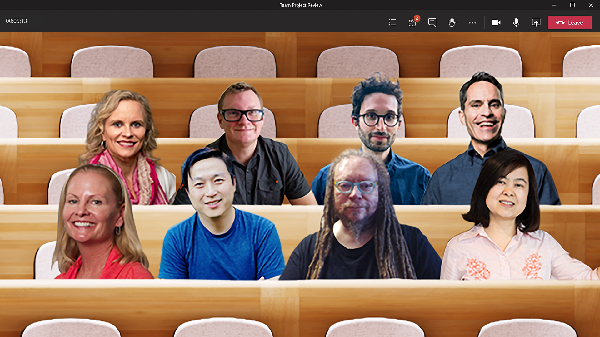
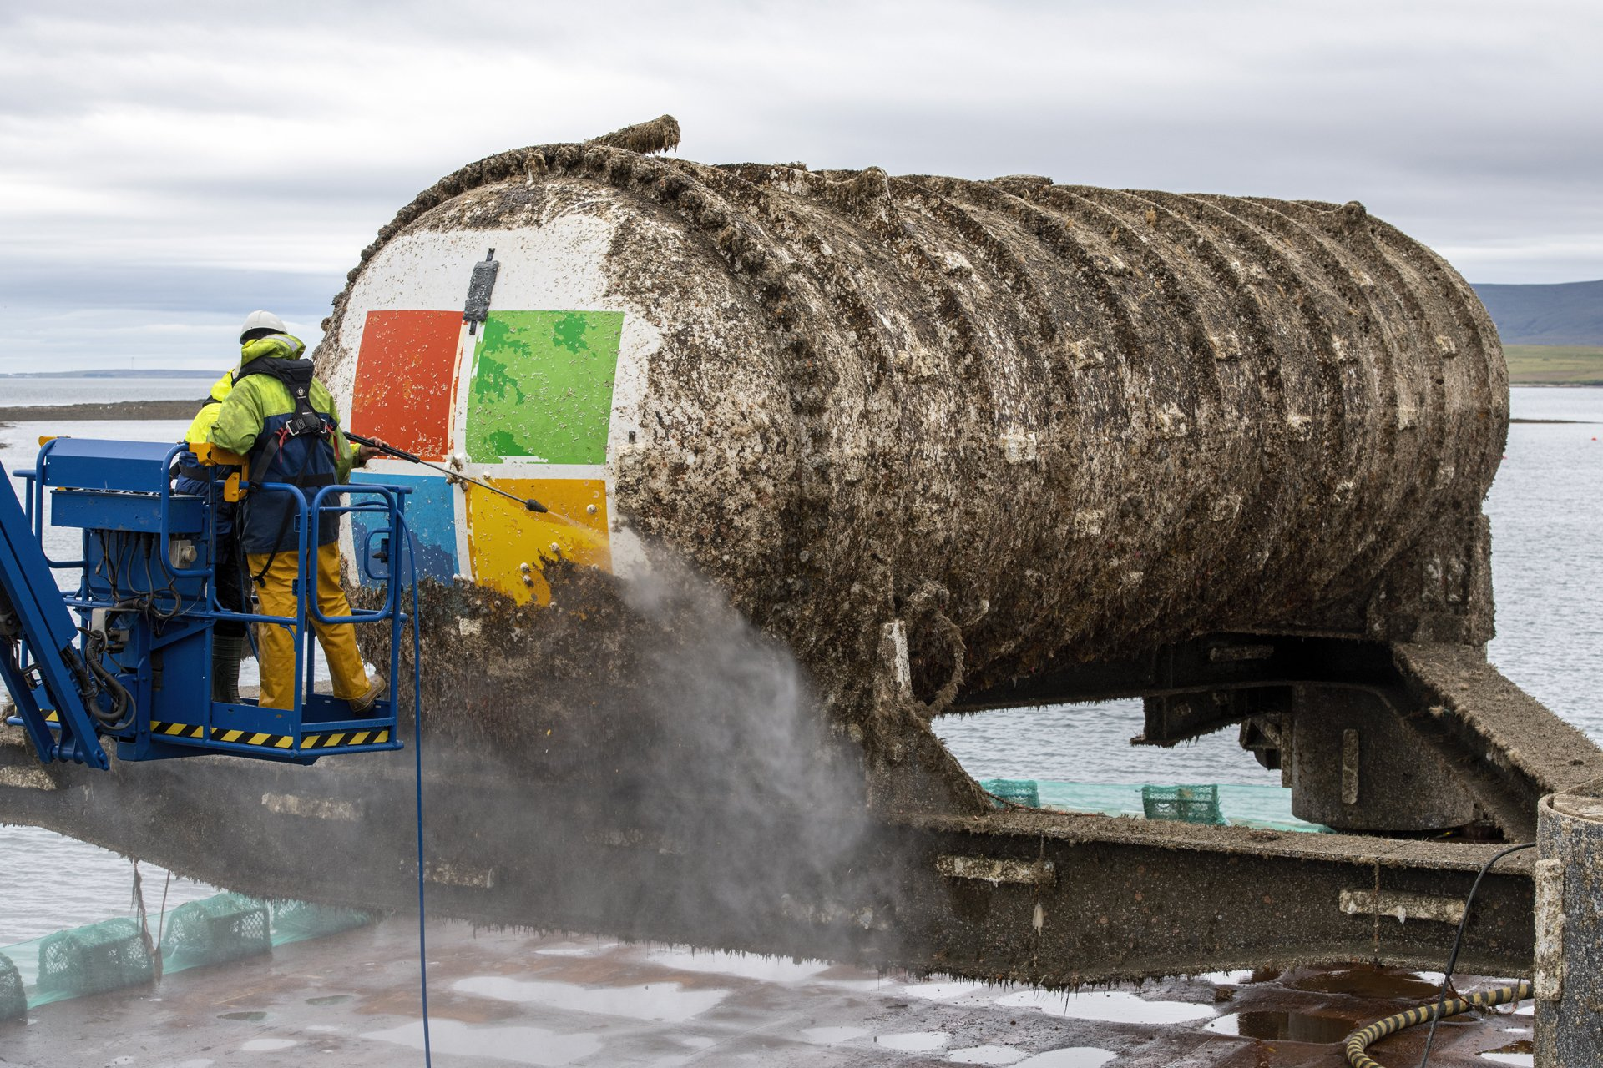


Microsoft Research: Projects
Product-aligned projects
Tangible impact to products and business
Disruptive projects
Define a moonshot and show that something is possible
Exploratory projects
Be driven by our curiosity and explore
Envision, create, build, solve, and lead. Work as a team to create impact.
Notes:
Our mission and ambitions align with how we approach research, which focus on two areas:
The first is curiosity-driven research, which is all about the future.
Second, deployment-driven research is typically when we work closely with products teams to bring immediate impact to products and the business.

Slide 6
Microsoft Research: Focus Areas
Intelligence
AI, Audio, Computer Vision, Graphics, HCI, NLP, IR
Systems
Data, Hardware, Programming, Quantum, Security, Networking, etc.
Theory
Algorithms, Mathematics
Other Sciences
Sustainability, Economics, Health, Social Sciences, Natural Sciences, etc.

Slide 7
My Research Journey
Information Retrieval
Human-Computer Interaction
Computational Health
Productivity - Task Assistance
Generative AI

Slide 8
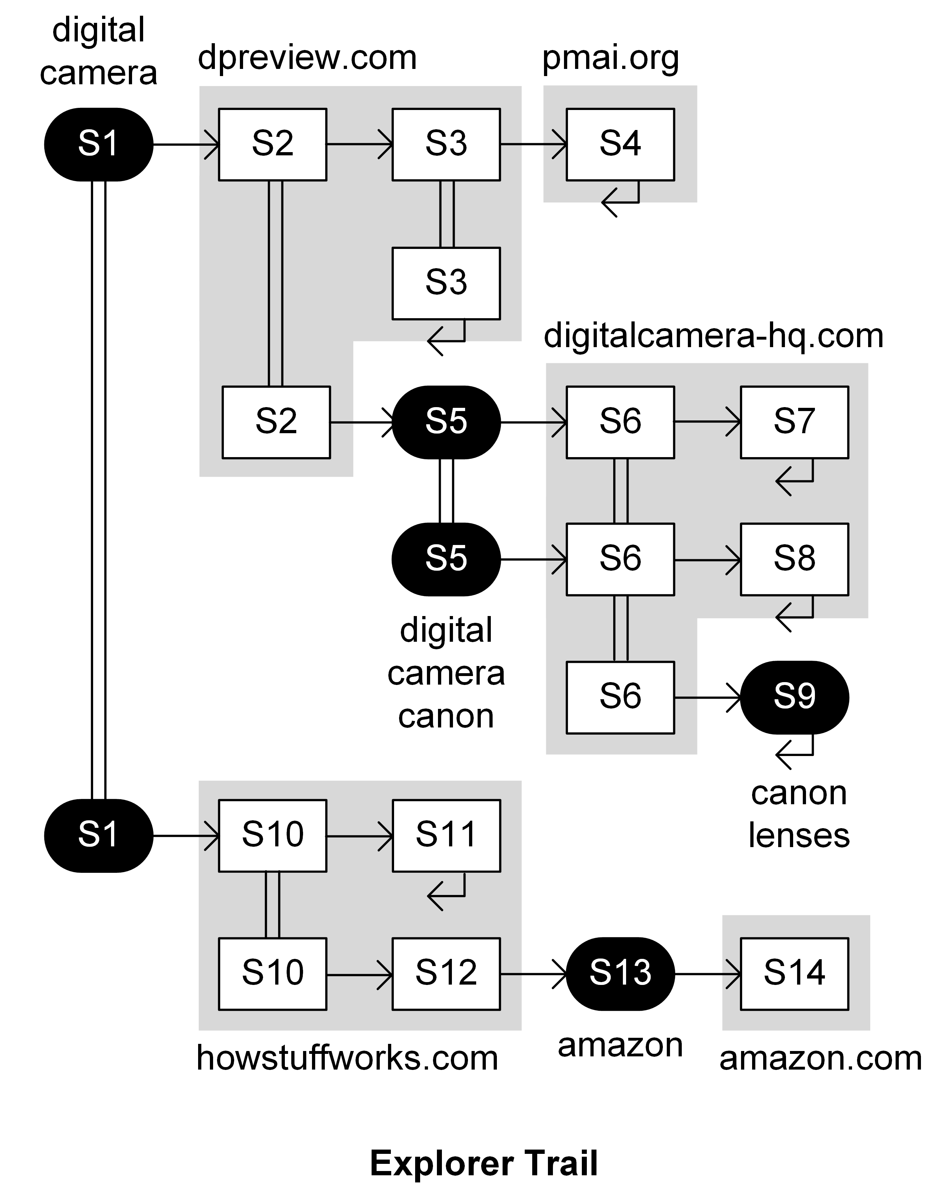
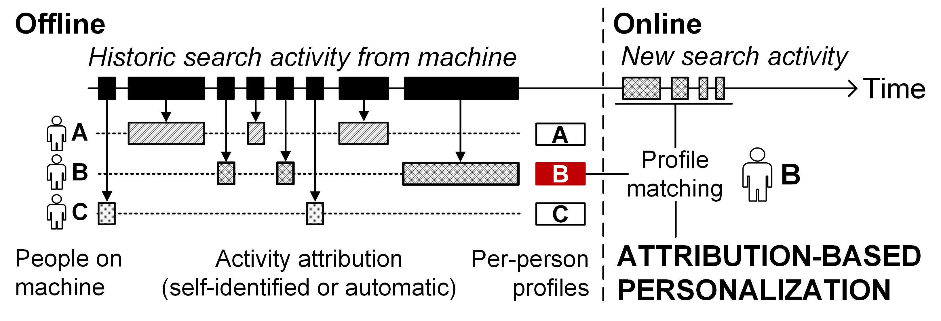
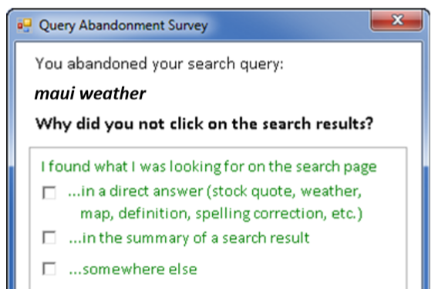
Understanding Search Interaction
Focused primarily on novel activity analysis, e.g.,
  Moving beyond search result clicks to full search and browse trails
  Activity attribution in
  multi-user settings such
  as shared devices
  Physiological sensing at scale via
  wearable devices (Microsoft Band)
  Cursor tracking at scale in Bing
Combined methods to obtain more insight than logs
  Extensive use of surveys, user studies, panels, etc.
WWW 2014, SIGIR 2015
WWW 2007, SIGIR 2007, …
  (strong relevance gains)
SIGIR
2017
SIGIR 2011, CIKM 2012

Slide 9
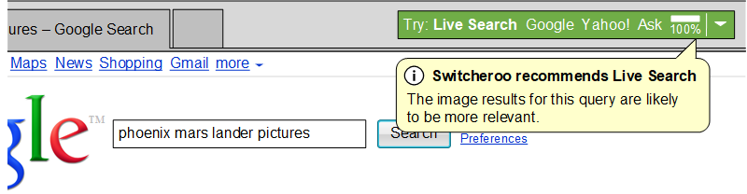
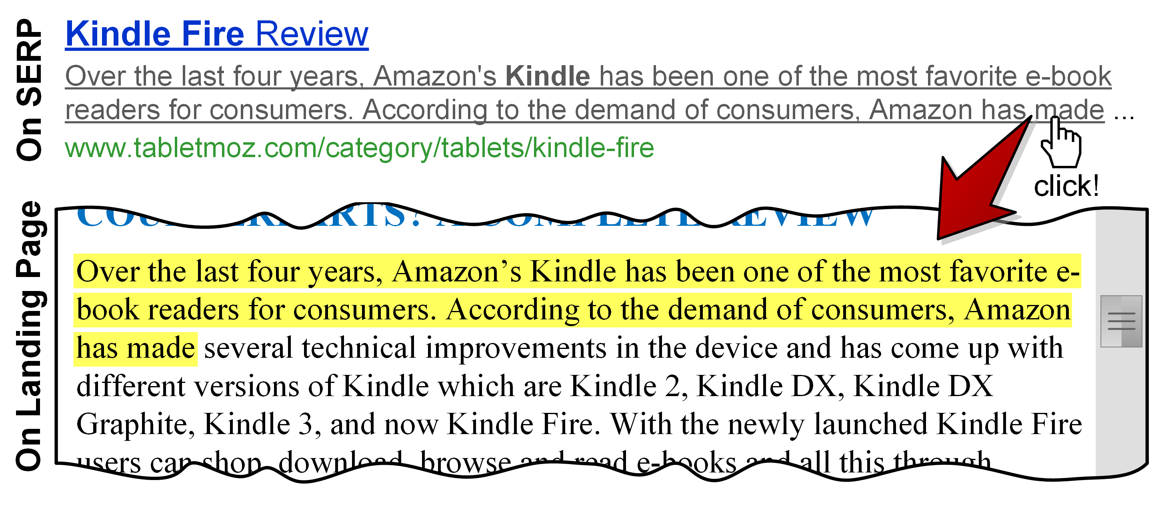
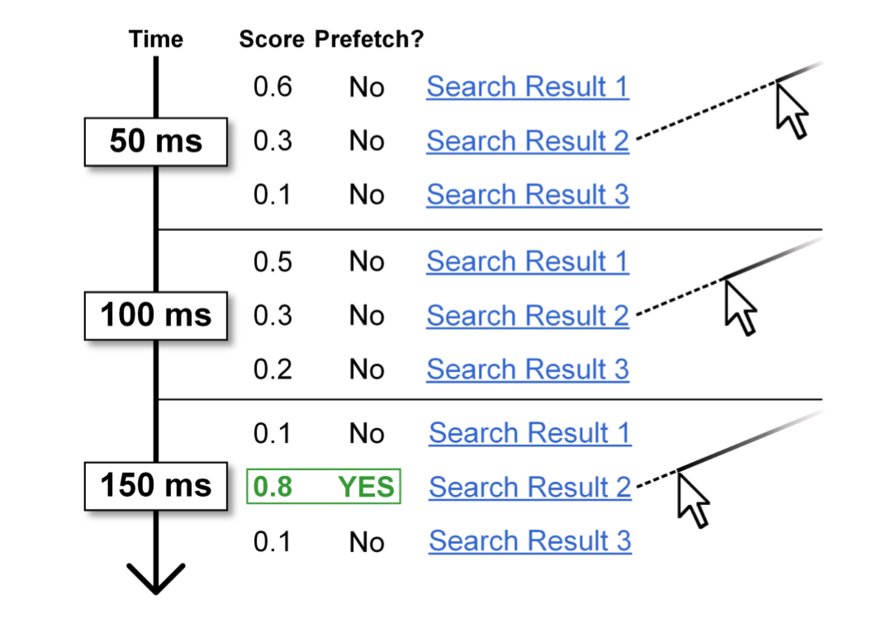
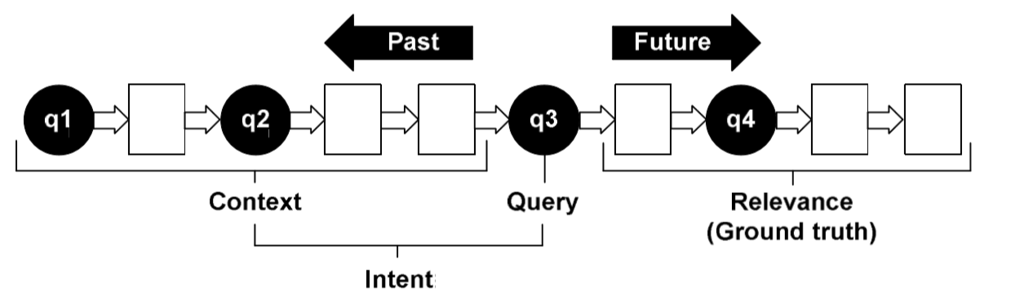
Supporting Search Interaction
My research has spanned many interactive and algorithmic solutions
Interactive support, e.g.,
  Search engine switching suggestions
  Clickable snippets – select
  snippet text to jump to
  that part of search result
Algorithmic support, e.g.,
  Pre-fetching search results using pre-click cursor trajectories
    Save users time – Fetch results before users click on them
  Contextual ranking via session data,
  location, reading level, etc.
    Shipped in Bing, covering most query traffic
SIGIR 2008
SIGCHI 2013
SIGIR 2016, ACM TOIS 2017
CIKM 2010, SIGIR 2012, …

Slide 10
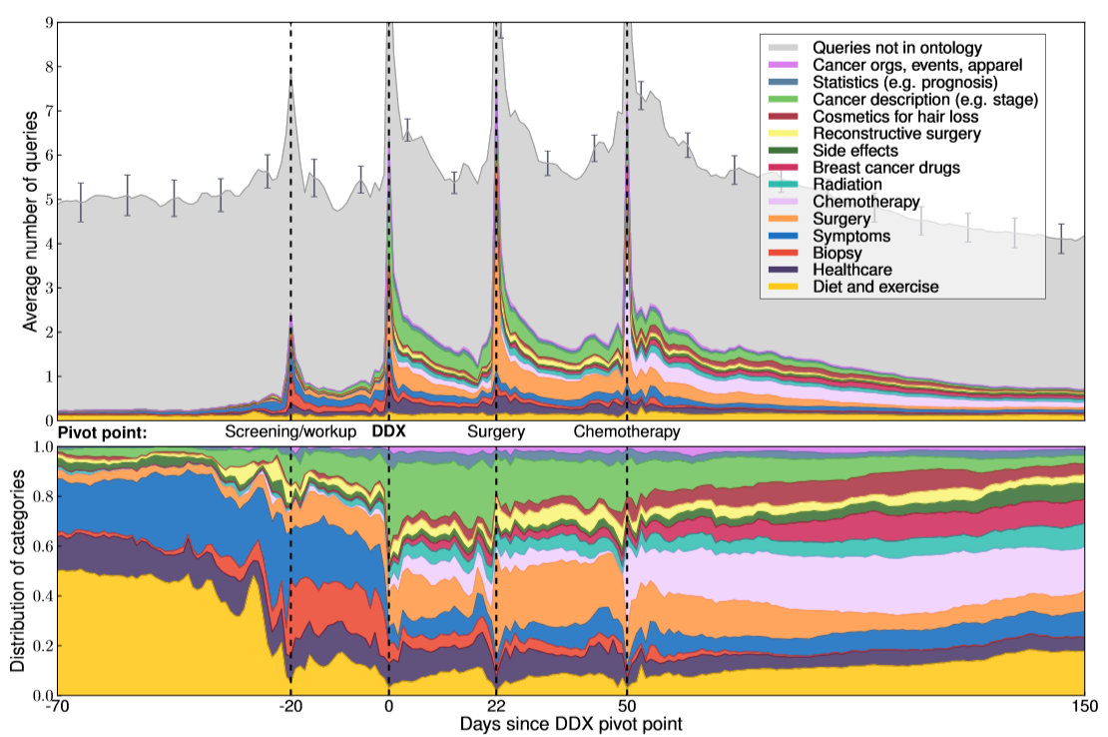
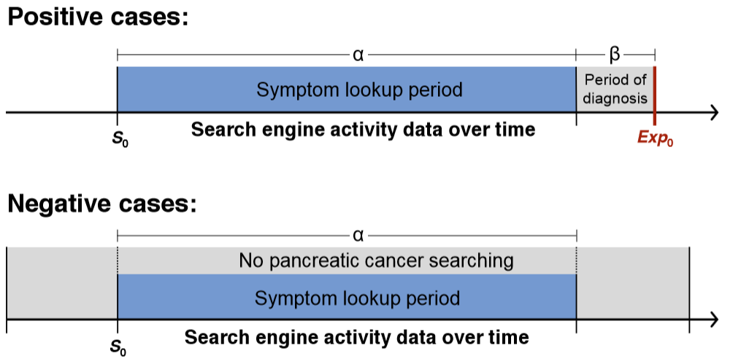
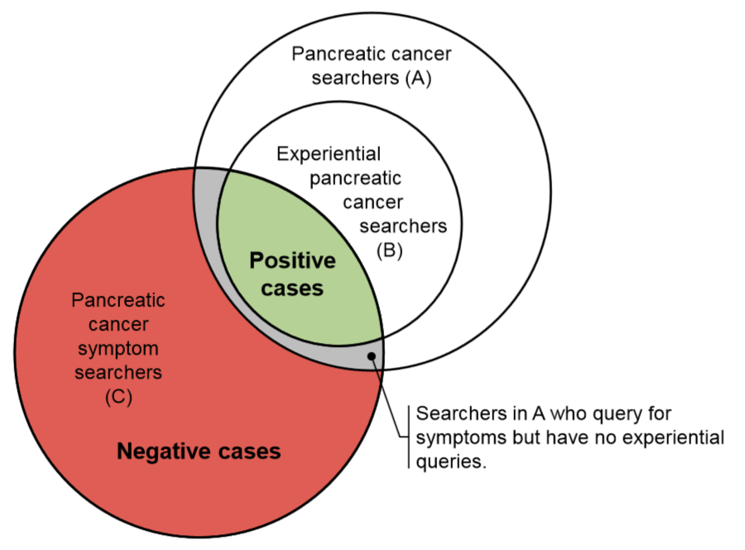
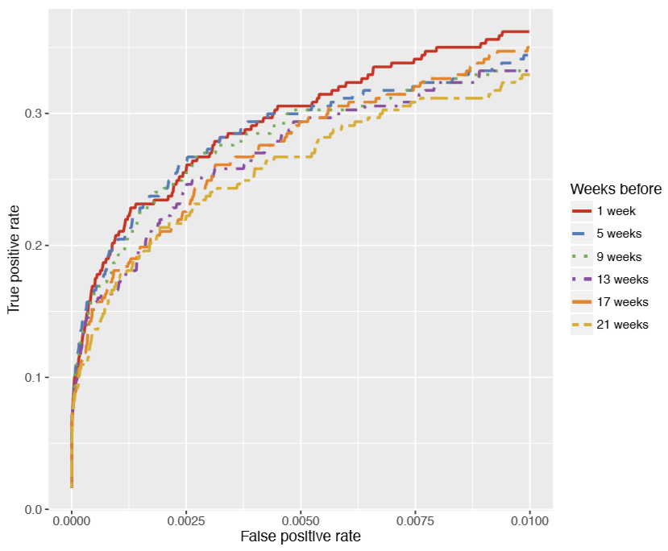
Health Search Interaction
Modeling intentions and building predictive models from aggregated, anonymized searches
Long-term breast cancer searching¹
Long-term pancreatic cancer searching²
Experiential
searches
“i was told i have pancreatic cancer what to expect”
“just diagnosed with pancreatic cancer”
“why did i get cancer in pancreas”
First symptom search
First experiential search
Early detection
AUROC: 0.9003
First experiential
BRCA DX search
Focus on
TPR at low FPR
¹ Paul, White, Horvitz. ACM TWEB 2016
² White, Horvitz. J. Oncology Practice 2016

Slide 11
My Research Journey
Information Retrieval
Human-Computer Interaction
Computational Health
Productivity - Task Assistance
Generative AI

Slide 12
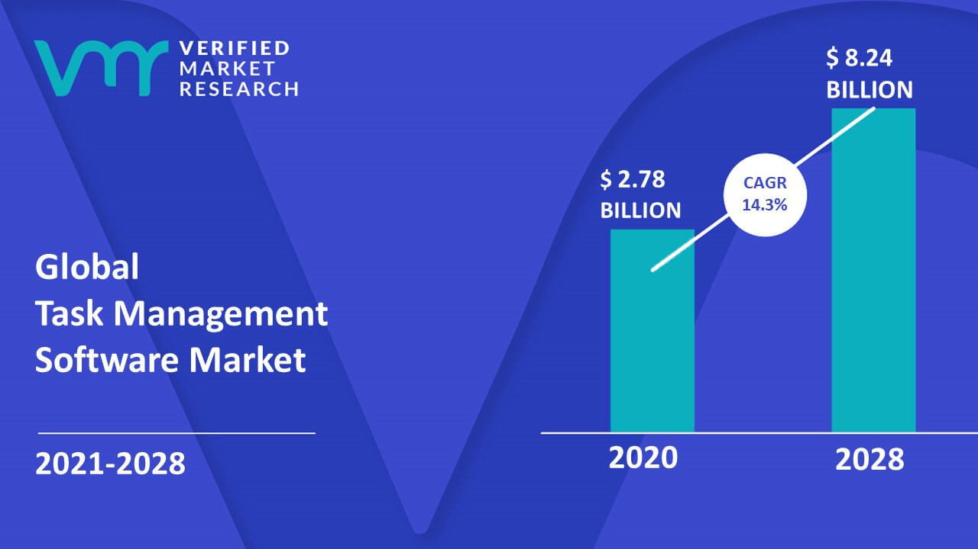

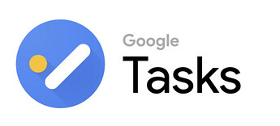




Tasks are Everywhere
Tasks are primary unit of personal and professional productivity
Large expected growth in global
task management software market
Many task management applications
Individual task app examples:
Team task app examples:

Slide 13
Tackling Tasks
New or pending items
Commitments, Requests, Errands, etc.
Many ways to tackle tasks
  Time blocking, Pomodoro, Kanban,
  Eat the Frog, Eisenhower matrix, etc.
Getting Things Done (GTD) principles
  Capture – Put new ideas on task list
  Clarify – Create actionable steps
  Organize – Prioritize, schedule, etc.
  Review – Revisit and revise regularly
  Focus – Execute on work per priorities
Yes (complex)
No
File or
Trash
Actionable?
Decompose
or Plan
Yes
For others
Next
action?
< 2 mins
Do it
Delegate
For me
Do ASAP or Schedule
Based on Allen. Getting Things Done. 2015
Notes:
5 steps
Task workflow

Slide 14


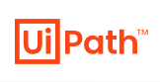

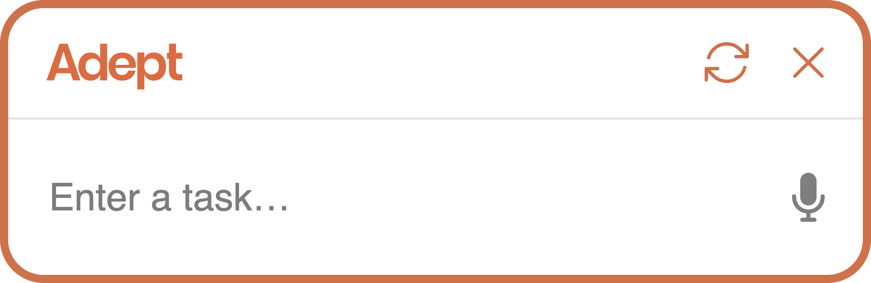
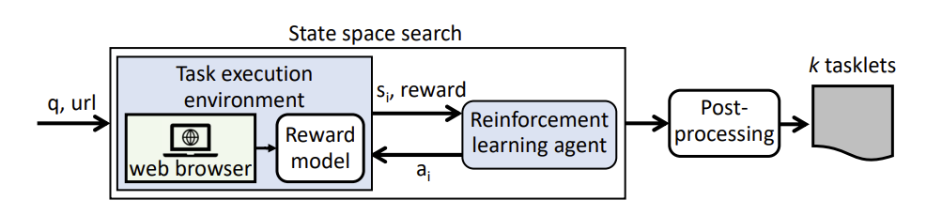
AI Can Help
Task Intelligence – Applications of AI for task assistance
Task Automation
  Robotic Process Automation – Software “robots” for repetitive tasks
  Action Transformers – Trained to use digital tools
  Learning “tasklets” from websites¹
  Less user effort. Less agility and no direct control.
Our Focus: Human Augmentation
  Human AI Teams – “Better together” experiences for task support
ACT-1 tackles tasks ranging from home finding to spreadsheet calculations
¹ Li and Riva. Glider: A Reinforcement Learning Approach to Extract UI Scripts from Websites. SIGIR 2021

Slide 15
Outline
Examples of task intelligence
Lessons on task intelligence
Effects of other factors
  Changing work habits
  Individual task styles
  Emergence of generative AI
Future directions in task intelligence

Slide 16
Examples of Task Intelligence
Digital Assistants (GTD: Clarify, Focus)
  Complex Task Support
To-Do Lists (Clarify, Organize)
  Task Decomposition, Task Prioritization, Task Duration Estimation
Email (Focus)
  Task Completion Detection
Other Aspects – Not covered today
  Task extraction, Task modeling, Search tasks (context, task-to-search), Evaluation, etc.
Notes:
Quickly go through some examples

Slide 17




Digital Assistants
Siri
We briefly cover: Complex Task Support

Slide 18
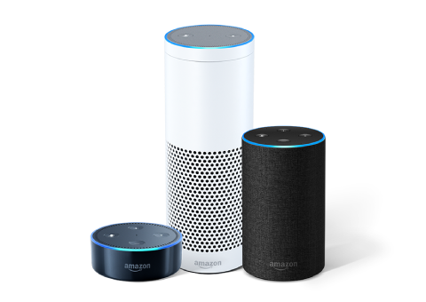



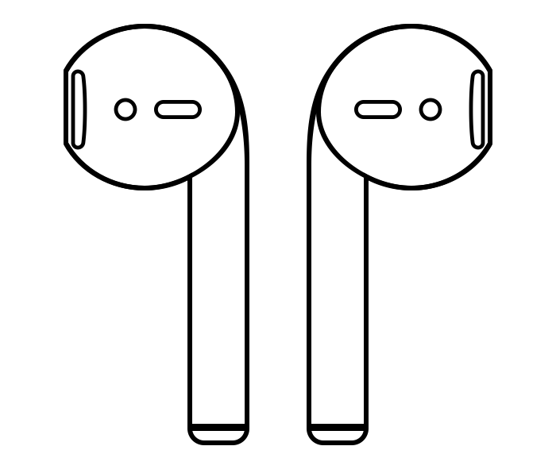
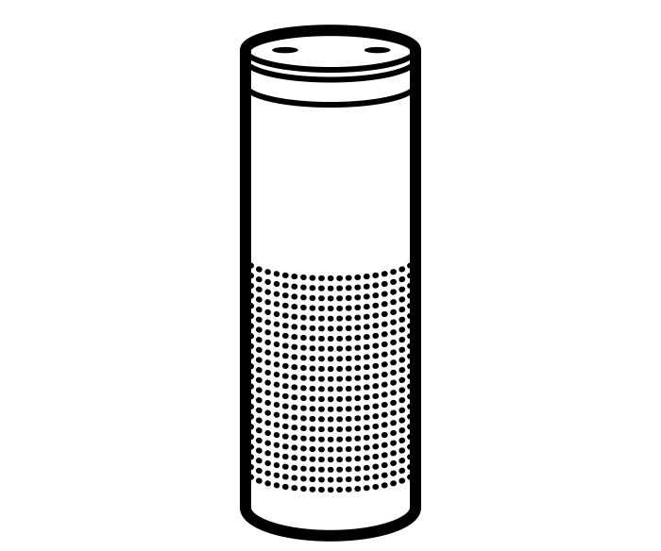
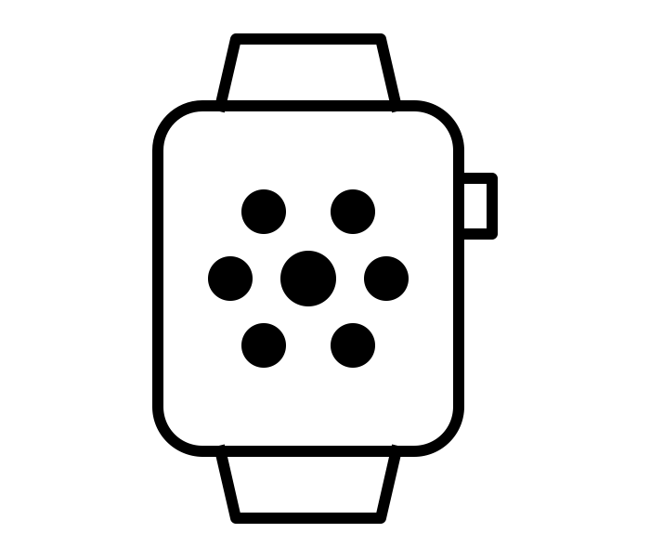
Supporting Complex Tasks
Current digital assistant scope
Expanded scope
Mainly used for simple tasks:
  Play song
  Set alarm
  Fetch weather status
  Etc.
Single device
Multi-step complex tasks
  Prepare and cook new recipes and dishes
  Follow step-by-step “how to” DIY instructions
  Complete homework tasks
  Play games
  Etc.
Multiple devices already owned by users

Slide 19
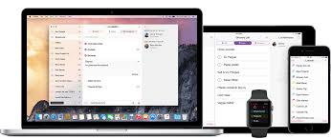
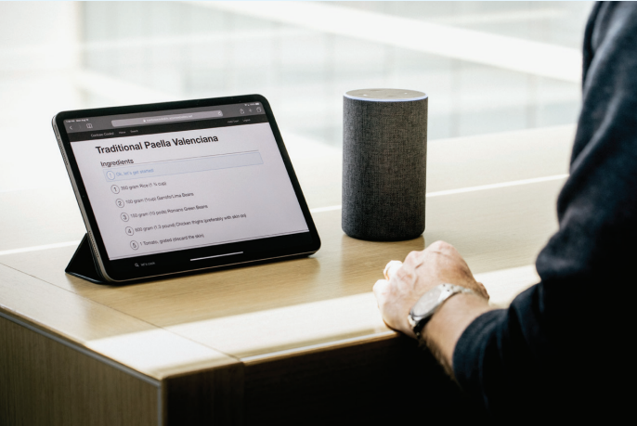

Multi-Device Experiences
Experiences spanning devices to better support complex tasks
+
Multi-modal
Cross-device
Hands-free
White et al. Multi-Device Digital Assistance. CACM 2019

Slide 20
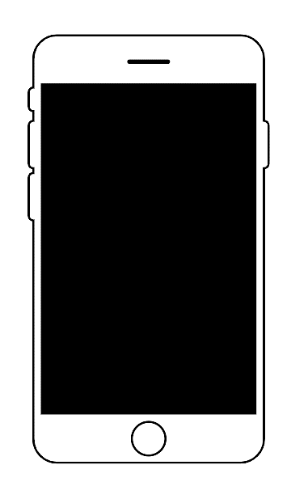


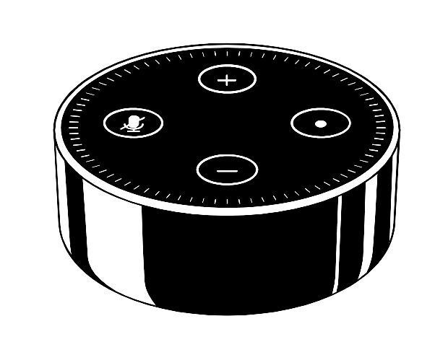
MDX vs. Other Cross Device Scenarios
Command & Control
Casting
Continuation
then
or
Device Adaptation (e.g., Alexa Presentation Language)
and
MDX
Better Together
Complementary capabilities
All devices (2+) are input and output
Used together simultaneously

Slide 21
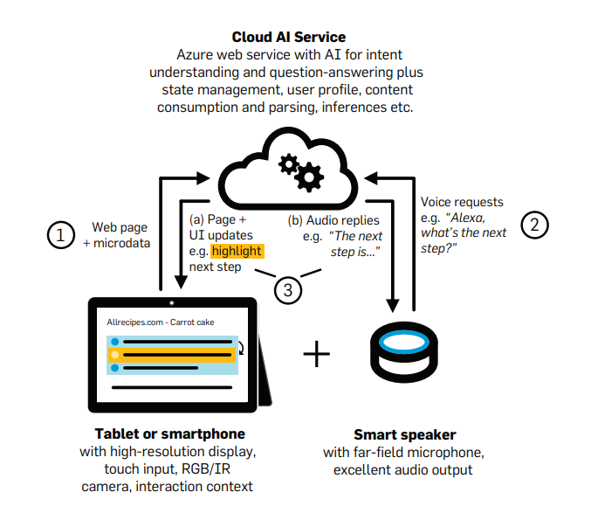
MDX Azure Service
Stepwise engagement with
websites via multiple devices
Core functionality:
  State reflection across devices
  Simultaneous readout across devices
  Website mining and step extraction
  Intent understanding
  Stepwise navigation
  Contextual Q&A
  Proactive recommendations
Basic flow:
  User visits MDX-enabled website
  Task steps are passed to service (flagged by author in HTML or auto-extracted)
  User requests next step or asks question via voice
  System responds on the screen and vocalizes through speaker
  (optional) System generates additional recommendations for current step
Notes:
Enable MDX on any website via JavaScript injection

Slide 22
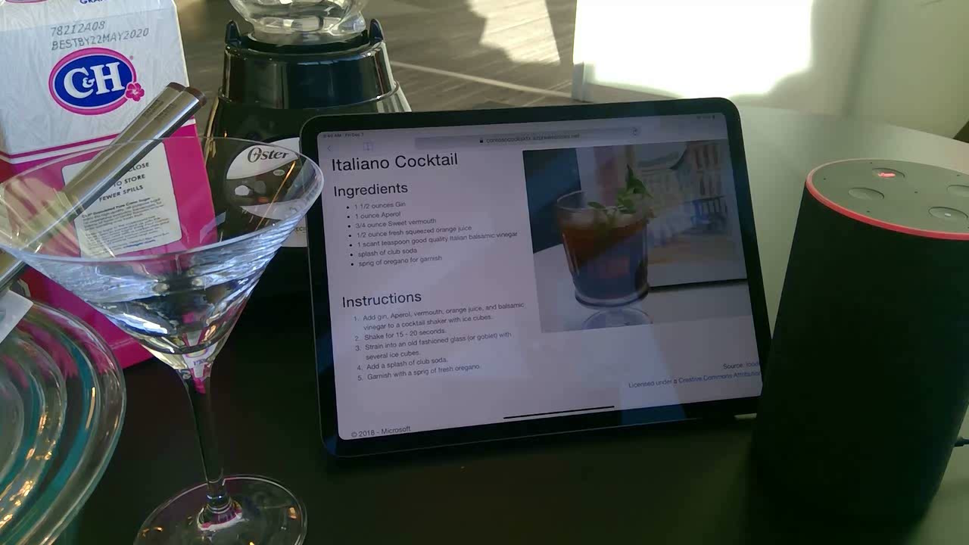
MDX - Guided Task Completion on iPad and Echo

Slide 23
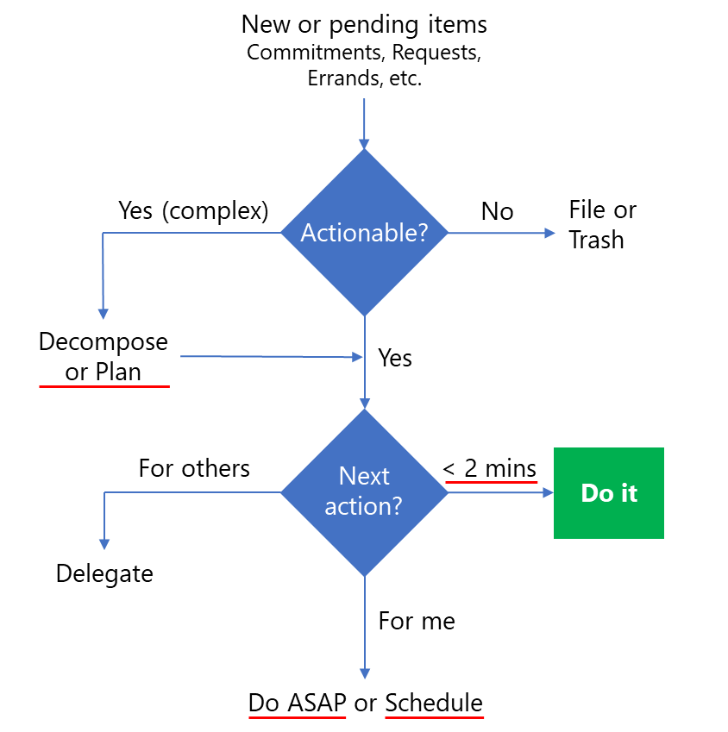
Task Lists
Task lists are common
  Take many forms: notepads, sticky notes, email
  More than 50% of adults keep to-do lists (80% in US)
  40% of to-do list items are never completed
  “To-do lists are where important tasks go to die.”¹
Many opportunities to help tackle these tasks
We briefly cover: Task Decomposition, Prioritization, Duration Estimation
¹ Kruse. 15 Secrets Successful People Know About Time Management. 2015.

Slide 24

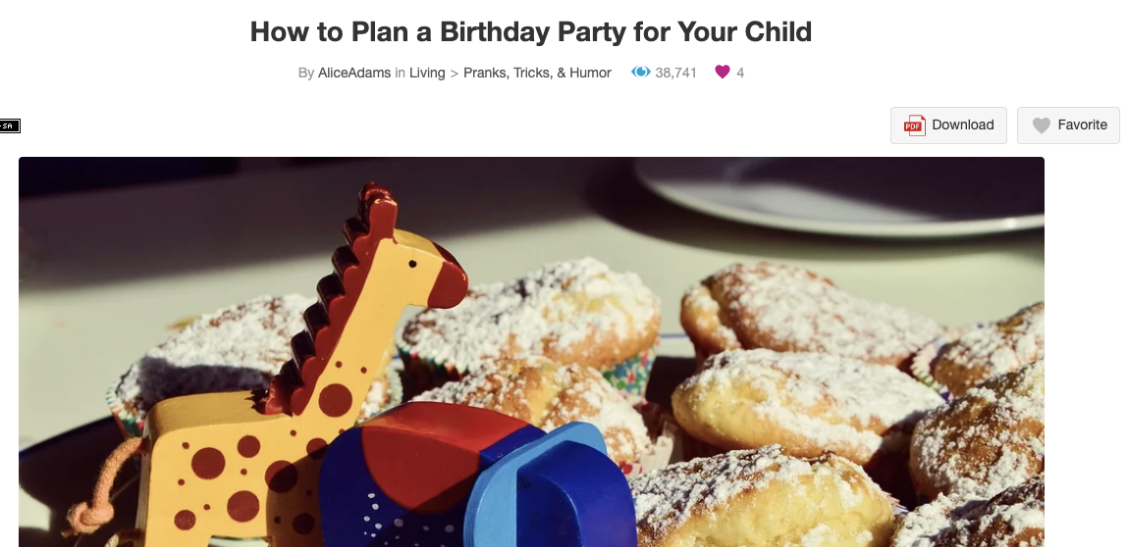
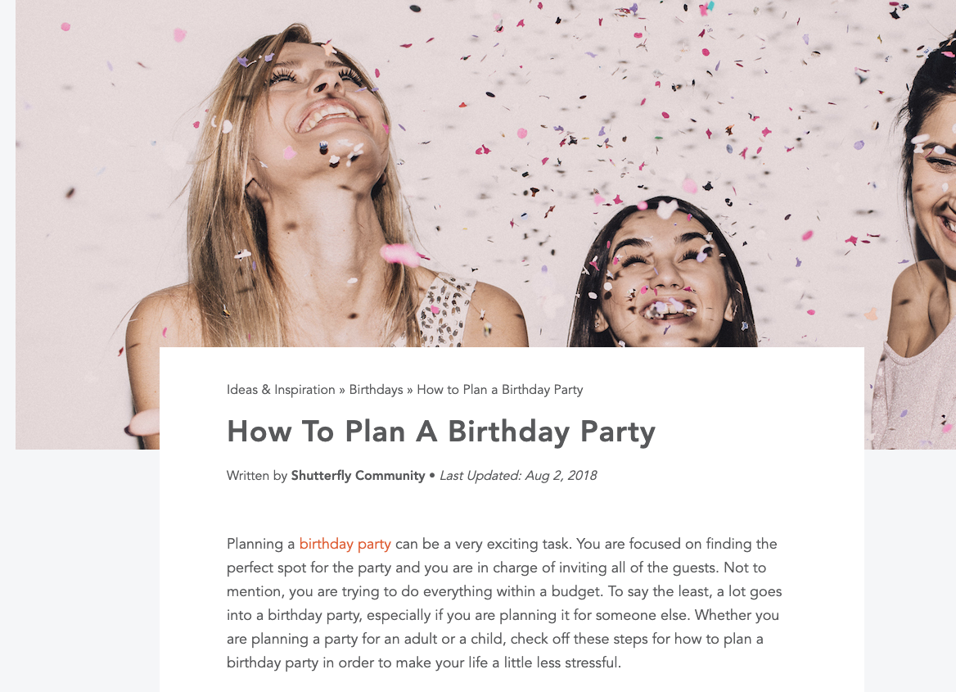
Task Decomposition
From complex to-do tasks to actionable steps and dependencies
Mine related queries and instructional articles from logs
1
Set up the time
Extract
or
Summarize the content
4
Buy food and beverages
2
Create a guest list
3
Send out invitations
Zhang, White, et al. Learning to Decompose and Organize Complex Tasks. NAACL 2021

Slide 25
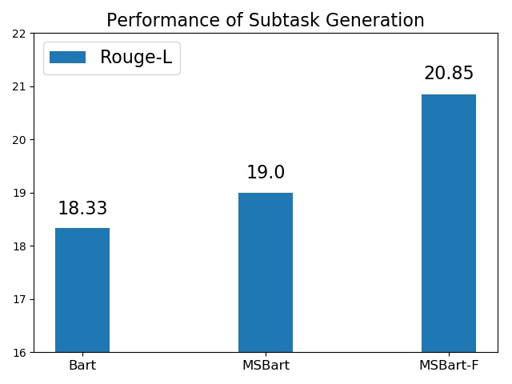
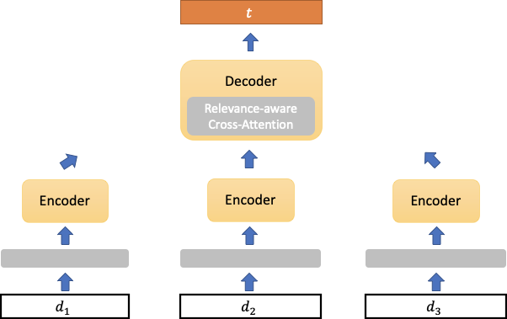
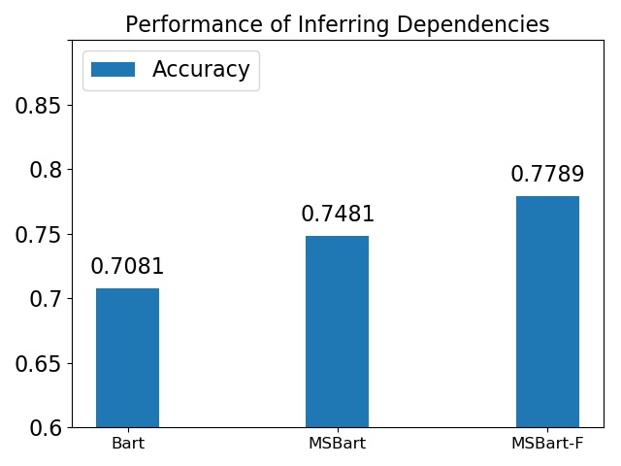

Task Decomposition
Extends BART (seq-to-seq summarizer) to handle multiple documents
Generate sub-tasks from complex task and collection of relevant docs
Create and release a dataset of complex tasks and dependencies
Model Output:
Select a date. Create a guest list. Prepare food and beverages. ...
Position Encoding:
For each token, map position id → real number
Cluster Encoding:
For each token, map sentence’s cluster id → real number
Sub-task Generation
Planning a birthday party can be a very exciting task. You are focused on ...
Celebrating one’s birthday is a special event that’s meant to be shared with loved ones ...
Sit down with your child and choose a party theme. Begin brainstorming how to incorporate ...
Relevant articles

Slide 26
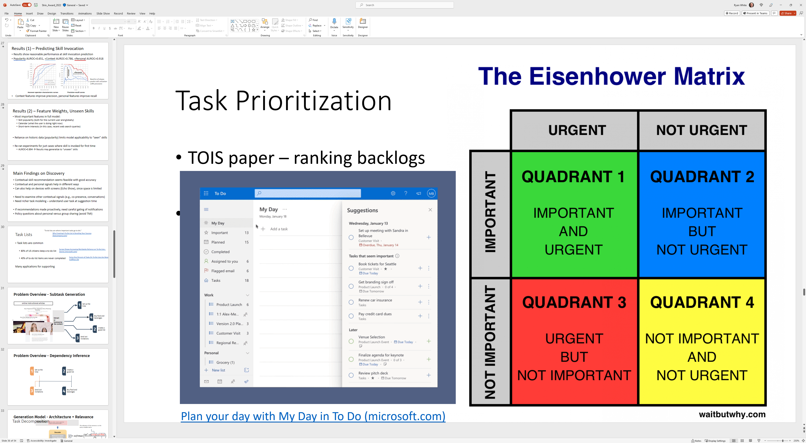
Task Prioritization
AI to auto-identify tasks that need to be done right away
Eisenhower matrix:
Task prioritization in To Do and Outlook:
 | Urgent | Not Urgent
Important | Important and urgent Do It | Important but not urgent Schedule
Not Important | Urgent but not important Delegate | Not important and not urgent Delete
AI can also prioritize task backlogs to help users decide on next steps
Notes:
Named after the 34th US President – Dwight D. Eisenhower

Slide 27
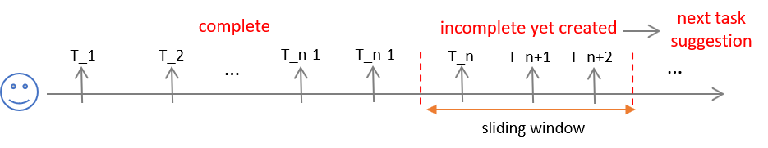
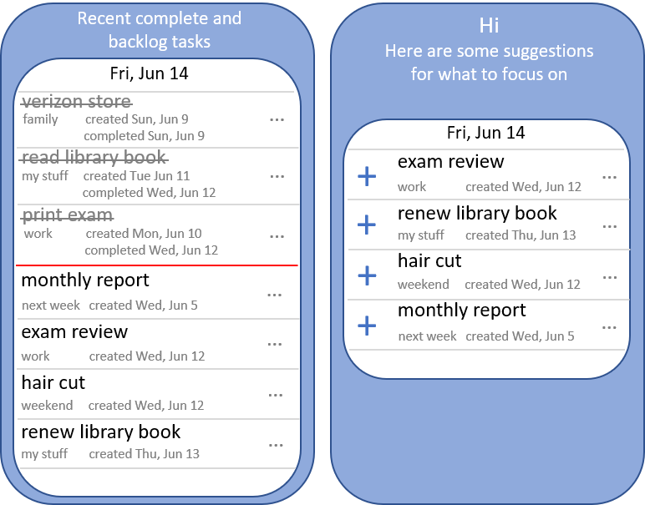
Task Prioritization
Given a user’s previous completed tasks and current backlog, rank to-be-completed tasks within next 1 day or next 1 week
Optimize for top ranked tasks
(recommendation) being completed
before the other tasks
Used anonymized tasks data from
Wunderlist task management app
Zhang, White, et al. Grounded Task Prioritization with Context-Aware Sequential Ranking. TOIS 2021

Slide 28
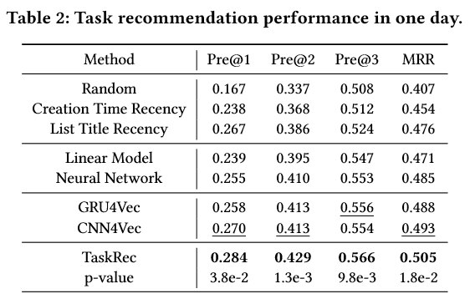





Task Prioritization
(a)
(b)
Task2Vec
$f_{θ} (f_{θ^{′}}$)
FC
Concat
Fri, Jun 14
embedding of
each previous task
verizon store
…
Task
Aggregator
list title
embedding
task title
embedding
context
embedding
family created Sun, Jun 9
completed Sun, Jun 9
Task2Vec
user
embedding
$$α_{1}$$
$$α_{k}$$
$$α_{1}$$
$$α_{k}$$
read library book
…
…
my stuff created Tue Jun 11
completed Wed, Jun 12
…
$$f_{θ}$$
.
.
.
$$f_{ε}$$
FC
word
embedding
…
…
print exam
…
…
pooling
…
pooling
work created Mon, Jun 10
completed Wed, Jun 12
C-RNN
…
C-RNN
C-RNN
…
C-RNN
00
monthly report
…
task title
context
features
next week created Wed, Jun 5
list title
read library book
…
exam review
…
Ranking
Optimization
my stuff created Tue Jun 11
completed Wed, Jun 12
work created Wed, Jun 12
$$f_{θ^{′}}$$
.
.
.
(c)
Task Aggregator
hair cut
…
$$f_{ε}$$
weekend created Wed, Jun 12
Task2Vec
pooling
.
.
.
renew library book
…
my stuff created Thu, Jun 13
embedding of
each backlog task
Task RNN
task
embedding
.
.
.
T1
T2
T3
Tk
TaskRec model has the best performance in all cases
Could utilize more context (cyclical/repeat tasks, location)
When and how to surface recommendations in UX is key challenge

Slide 29
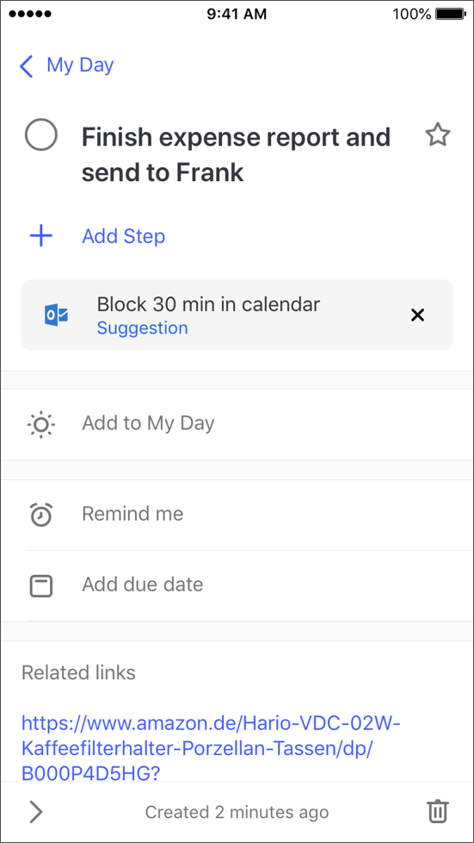
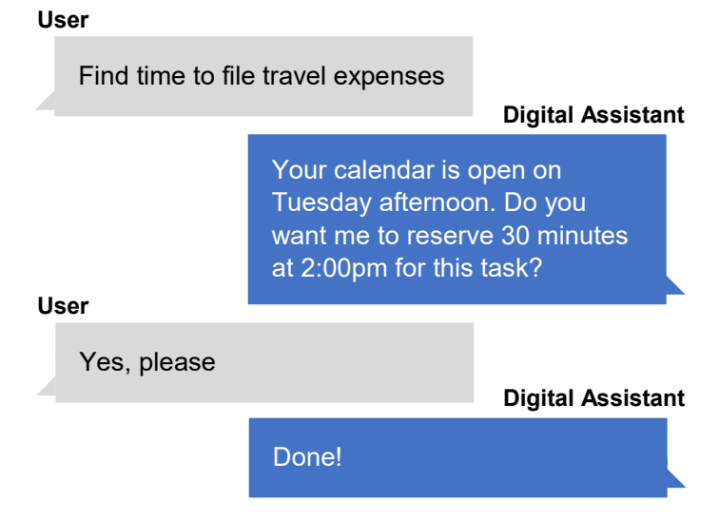
Task Duration Estimation
Block enough time to get tasks done
  “Schedule everything” productivity hack
Suggest time to block on user calendar based on task duration estimation

Slide 30
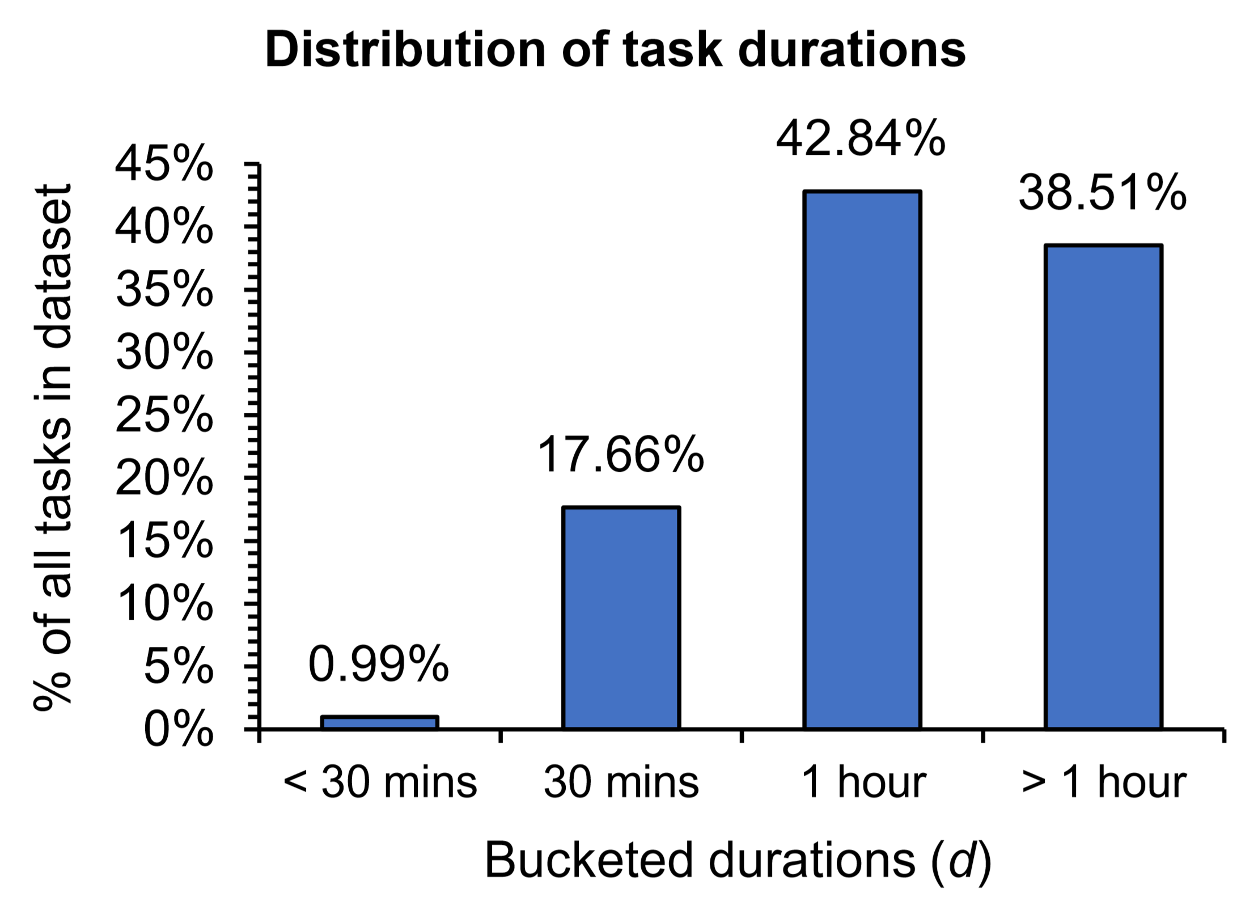
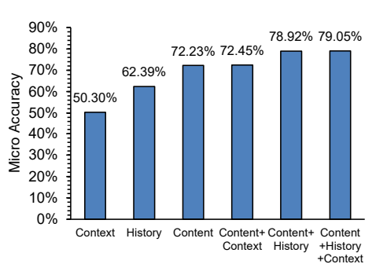
Task Duration Estimation
Calendar appointments from Cortana
  >3M anonymized appointments from 700k users
Learn from time blocked by users
Experimented with logistic regression and
Bi-directional RNN with attention
RNN performs best (~80% accuracy)
  Text content features especially useful
White and Awadallah. Task Duration Estimation. WSDM 2019
Notes:
As you can see the calendar data is skewed in favor of longer tasks which is expected. Meanwhile, tasks which people input to todo app are potentially different. Therefore, the model that we trained needed to be robust to the domain shift.

Slide 31
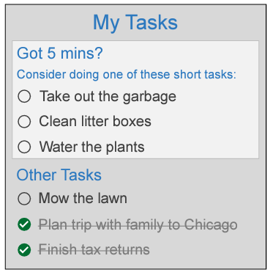
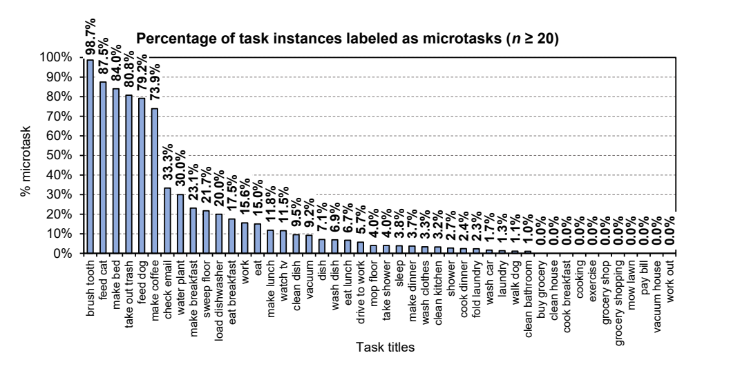
Microtask Detection (5 mins or less)
Collect data on task durations from crowd workers
Train classifier to detect microtasks (Accuracy: 90%, marginal: 17%)
Not all tasks are actionable (70% of tasks in to-do lists are not)
  Analyzed anonymized, aggregated Wunderlist data
  Most are grocery items, Movies to watch, Books to read, etc.
Identifying actionable tasks is important
White et al. Microtask Detection. TOIS 2021

Slide 32
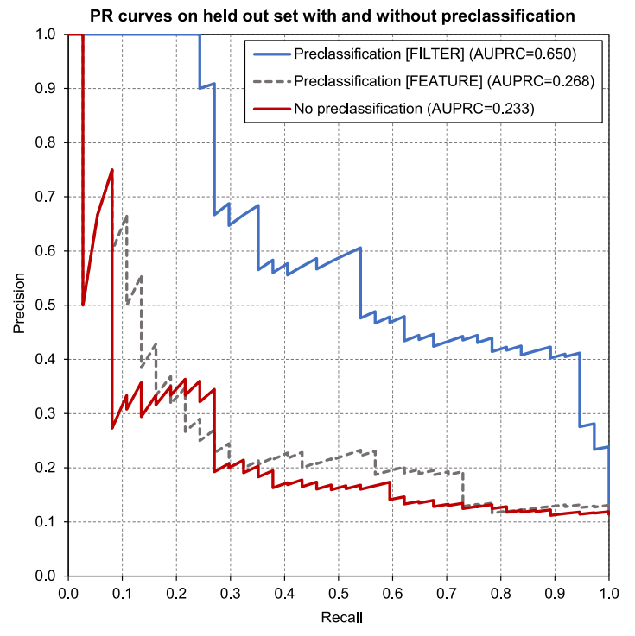
Microtask Detection
New or pending items
Commitments, Requests, Errands, etc.
Pre-classifiers to select or upweight actionable tasks
Yes (complex)
No
File or
Trash
Actionable?
Decompose
or Plan
Yes
For others
Next
action?
< 2 mins
Do it
Delegate
For me
Do ASAP or Schedule

Slide 33
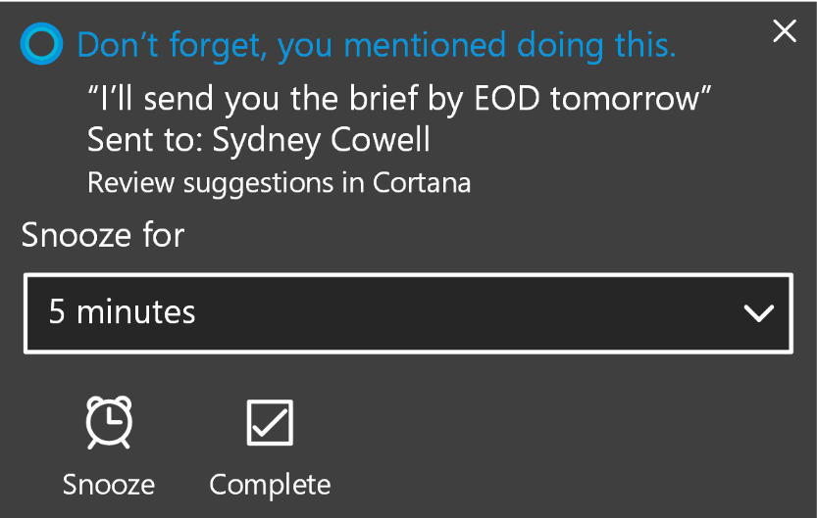
Email
Email used to make promises, requests, to-do lists (“self-e’s”), etc.
Cortana extracts commitments made
by users in email – these are tasks
  “I will send you the report”
  “I’ll get back to you by EOD”
Initial experience shipped in 2017
Statistics:
  24% of commitments have a due date
  Most tasks completed within a few days of creation
We briefly cover: Completion Detection

Slide 34
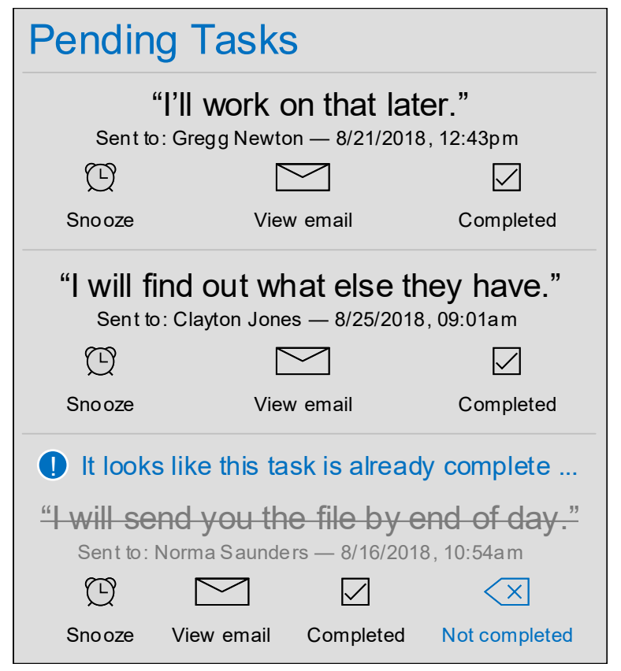

Completion Detection
Auto-detect when tasks are done
Suppress reminder notifications
Learn models from feedback data
White et al. Task Completion Detection. SIGIR 2019

Slide 35


Completion Detection
Various factors affect time to task completion
Some email tasks can
be handled as quickly
as a phone call
High priority tasks are completed faster
Relative completion timing: Call < Email < Investigate
Connected to task complexity

Slide 36
10 Lessons on Task Intelligence from our work on research and product

Slide 37
Lessons Learned
Lightweight task capture / task extraction is essential
  Many people still do not use task management software
  People do not want to spend time enumerating tasks
Integration with existing applications is important
  Uptake of separate task management apps slow and misses application context
Limited information on task completion, need proxies
  Many completion events hidden, making task models difficult to develop
Tasks span application, device, and session boundaries
  Difficult to track task progress through limited lens
Multiple devices may be needed to perform a task effectively
  Need to develop multi-device experiences for some task types (complex tasks)

Slide 38
Lessons Learned
Many factors contribute to complex task attributes, such as priority
  Need to be fully modeled to build provide optimal assistance
Tasks are personal and context dependent
  Situational aspects need to be better understood and represented
Task feasibility is important dimension that is poorly understood
  Need to understand task resources required and represent their availability
Task repetition, within and between users, is common
  Systems could do more to help – show previous solutions, etc.
Tasks can reveal sensitive information, so privacy risks are paramount
  Potential to leak information explicitly (passwords in task lists) or implicitly (activity streams)
  Need mitigations such as differential privacy and privatized federated learning in analysis and use

Slide 39
Effects of Other Factors

Slide 40



Effects of WFH
Surveys of Microsoft employees before and during pandemic
Changes in work practices and tool use – blurrier work-life boundary
Opportunities for (at least):
Accelerated task capture
Interoperable task tools
Explicit support for maintaining task boundaries
Williams, White et al. Managing Tasks Across the Work-Life Boundary. TOCHI 2023
Notes:
150 MSFT employees pre-pandemic (2019)
70 MSFT employees during pandemic (2020)

Slide 41

Task Personas
Task management personas derived from interviews and surveys with users of the Wunderlist to-do application. Credit: Carina Stefes
Offer help selectively and be prepared to adapt to individual user styles

Slide 42



Generative AI
Emerging opportunities for task support via large-scale foundation models
Examples:
  GitHub Copilot – Your AI pair programmer
  ChatGPT – Conversational task assistance
  New Bing – AI-powered answer engine

Slide 43
Future Directions for Task Intelligence with research topics and connections to Computer Science in general

Slide 44
Future Direction | Matching GTD Principle | Examples of General CS Research Topics That Can Contribute | Examples of Task-Related Research Topics
Better Understand Tasks to Enable More Intelligent Assistance | Capture, Clarify | Language understanding (especially short texts) Intent understanding Context modeling | Task understanding and modeling from language and activities (task2vec) Screen to task understanding (pixel2vec) Mining action graphs from websites
Enhance Task Planning and Support Goal Attainment | Clarify, Organize | Time management Goal understanding and modeling Situational intelligence | Task feasibility Task progress estimation Task repetition Complex task (or goal) decomposition into microtasks
Improve Task Outcomes via Human-AI Cooperation | Organize, Focus | Nudges Coaching Explanations Human-AI teaming Conversational AI | Task reminders Task suggestions (hints, tips, etc.) Task-oriented dialog systems
1.
2.
3.
White. Intelligent Futures in Task Assistance. CACM 2022

Slide 45
Future Direction | Matching GTD Principle | Examples of General CS Research Topics That Can Contribute | Examples of Task-Related Research Topics
Boost Task Productivity for Individuals and Teams | Review, Focus | Hybrid work Work-life balance Gig economy Robotic process automation Action transformers Teamwork (roles, delegation, dependencies, etc.) | Microproductivity Task marketplaces Task automation Project (team task) management (assignment, sequencing, load balancing, etc.)
Provide Holistic Support to Facilitate Task Completion | Focus | Intelligent assistance Longitudinal user histories and analysis Cross- and multidevice experiences | Cross-session task continuation Cross-app task workflows (for example, from to-do applications to search engines) Cross- and multidevice task completion
4.
5.

Slide 46
Future Direction | Matching Principle | Examples of General CS Research Topics That Can Contribute | Examples of Task-Related Research Topics
Refine Assistance over Time via Feedback Loops | Foundations | Personalization Contextualization User modeling Cohort modeling | Task prioritization Task recommendations
Expedite Progress via New Datasets and Evaluation Methods | Foundations | Datasets Experimentation | Shared tasks datasets Tasks competitions (e.g., Alexa TaskBot challenge) Tasks-based evaluation metrics
Build and Maintain User Trust | Foundations | Privacy preserving machine learning FATE Client-side and hybrid inference | Removing and securing sensitive information in to-do task data (passwords, etc.) Private inference on observational task activity data De-biasing team task management assignments
6.
7.
8.

Slide 47


Closing
Tasks are everywhere. Central to personal and professional productivity
Task intelligence can empower us, help us get things done
Many opportunities to improve task management
  Automate repetitive tasks
  Integrate with and enhance existing task workflows
  Support for both individuals and teams
Focused on digital world in this talk
  Expansion to physical world via mixed reality
Generative AI will change task assistance, starting with complex/creative tasks

Slide 48
Thank you again.
Questions?

Slide 49
Appendix

Slide 50


Skill Discovery
Digital assistants have many capabilities
Affordances are unclear
  Especially on headless devices (no display)
  User requests/commands are based on
  their experiences and expectations
Assistance is often best offered at the
time of need
  More likely to stick and be remembered later
  Users likely to forget if skill suggestions are
  separated in time (e.g., periodic emails)
Headless devices (smart speakers)
Cumulative # of Alexa skills over time
* Only partial data available
White. Skill Discovery in Digital Assistants. CACM 2018.

Slide 51



Skill Discovery - Role of Context
Context important determinant of skill relevance and assistant utility
Analysis of skill usage data shows usage varies depending on context
  E.g., from analyzing Cortana data from internal deployment:
Sleep skills used more at home in the evenings
Productivity skills used more at work during the day
Sleep sounds
skill
Productivity
skill
All skills
@Home
@Work
Local time and location are important context signals that are easy to obtain

Slide 52

Contextual Skill Recommendation
User
Hey Cortana,
help me now!
Learn skill recommendations based on context
Support query-less skill suggestion and task completion
Generate set of contextual features from Cortana data
Features:
Assistant
Here’s what I can do to best help right now …
User
Let’s …
Features | Description | Example features
Popularity | General popularity of the skill across all users (using only historic usage data from before the skill was invoked) | Historic skill usage count, historic skill user count
Context | Contextual signals describing when the skill is used | Calendar (meeting duration, subject*), visited venues (type, duration, name*), local time, to-do list items*, search queries (in last 30 mins*, in last 30 days*), applications used*, etc.
Personal | Features corresponding to the user who invoked the skill, e.g., popularity of the specific skill for that specific user | Historic skill usage by current user within the last 30 mins, within the last 30 days, and all time
* Used semantic representation

Slide 53


Predicting Skill Invocation
Results show reasonable performance at skill invocation prediction
Popularity AUROC=0.651, +Context AUROC=0.786, +Personal AUROC=0.918
+Context
+Personal
Baseline of always predict skill utilization (19% precision)
Receiver-operator characteristic curves
Precision-recall curves
Context features improve precision, personal features improve recall

