Slide 1
Tasks, Copilots, and the Future of Search
Ryen W. White
General Manager and Deputy Lab Director
Microsoft Research Redmond
ryenw@microsoft.com

Slide 2
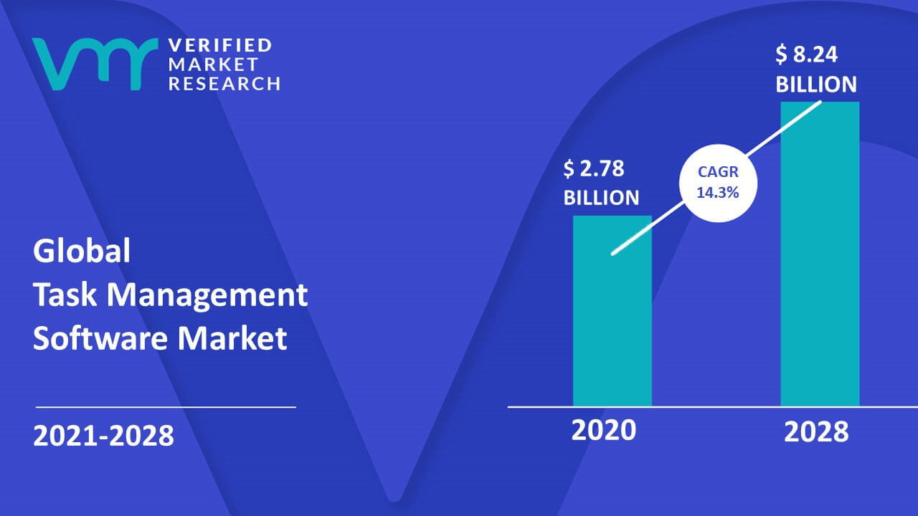






Tasks are Everywhere
Tasks are primary unit of personal and professional productivity
Large expected growth in global
task management software market
Many task management applications
Individual task app examples:
Team task app examples:

Slide 3
Tasks Motivate Searching
Gaps in knowledge, problematic situations, etc.
Many info seeking models consider task - ASK, Sensemaking, etc.
Bridge (Solution)
SPACE
Generator
Information
Searcher
Situation
Outcome
Purposeful
Meaningful
Requested
Desired
(ASK - Gap)
Gap
Anomalous States of Knowledge¹
TIME
Sensemaking²
^{1.} Belkin (1980) Anomalous States of Knowledge as a Basis for Information Retrieval. Can J Inf Sci
^{2.} Dervin (1998). Sense‐making Theory and Practice. J Knowl Manag

Slide 4
Outline
Importance of considering task in supporting search
Searcher struggles with complex tasks in particular
Some IR research on methods to support complex tasks
Emergence of generative AI and copilots to offer further assistance
(Some) implications of these advances for the future of search

Slide 5
Taking Search to Task
Stages of task execution
  Pre-focus, focus formulation, post-focus [Vakkari]
Multiple levels of tasks [Byström, Savolainen]
Facets of tasks [Li, Belkin]
Tasks defined on intents:
  Informational, transactional, navigational [Broder]; Well-defined or ill-defined [Ingwersen]; Lookup, learn, investigate [Marchionini]
Hierarchical structure of tasks [Xie]
Characteristics of tasks, and task/searcher interaction
  E.g., Difficulty, complexity [Kim; Byström & Järvelin]

Slide 6
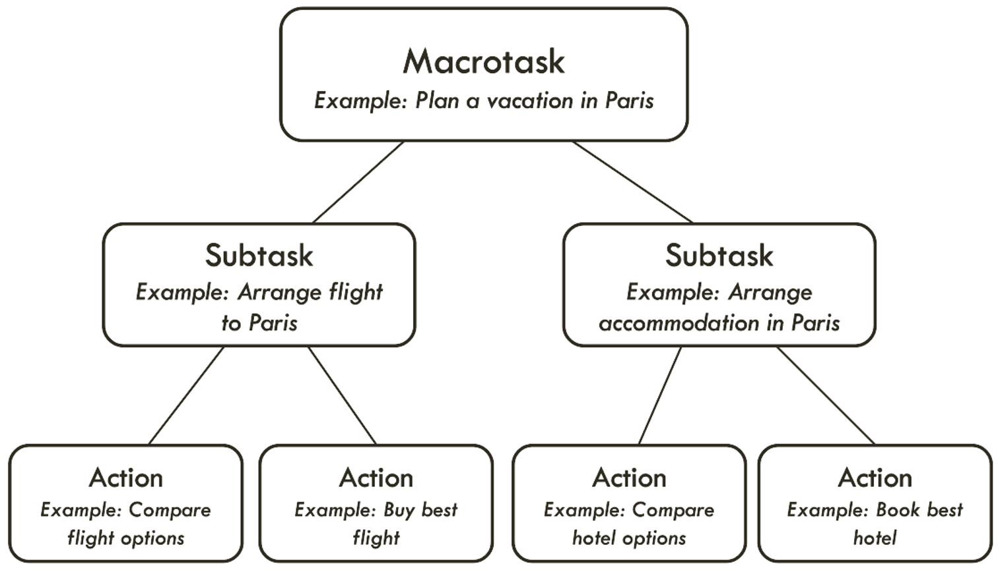
Tasks as Trees
Tasks in a hierarchy – framing device
Only actions observable in search
  Macrotasks/subtasks now
  more observable with NL/dialog
Moves map to task applications
  Left to right: Task prediction
  Up: Task recognition
  Down: Task decomposition
Challenges
  Representing tasks
  Observing more task-relevant activity and content
  Developing task-oriented interfaces
  Task decomposition
  Task recognition
  Task prediction
Shah, White, Thomas, Mitra, Sarkar, Belkin (2023) Taking Search to Task. CHIIR.

Slide 7
Focus on Complex Search Tasks

Slide 8
Search is Not Solved
Estimates are that half of searches are not answered [Bing analysis¹]
Many of those searches are connected to complex search tasks
Complex search tasks
  Ill-defined and/or multi-step
  Span multiple queries, sessions, and/or devices
  Require deep engagement with search (many queries, backtracking, branching, etc.)
^{1.} Reinventing search with a new AI-powered Microsoft Bing and Edge, your copilot for the web - The Official Microsoft Blog

Slide 9
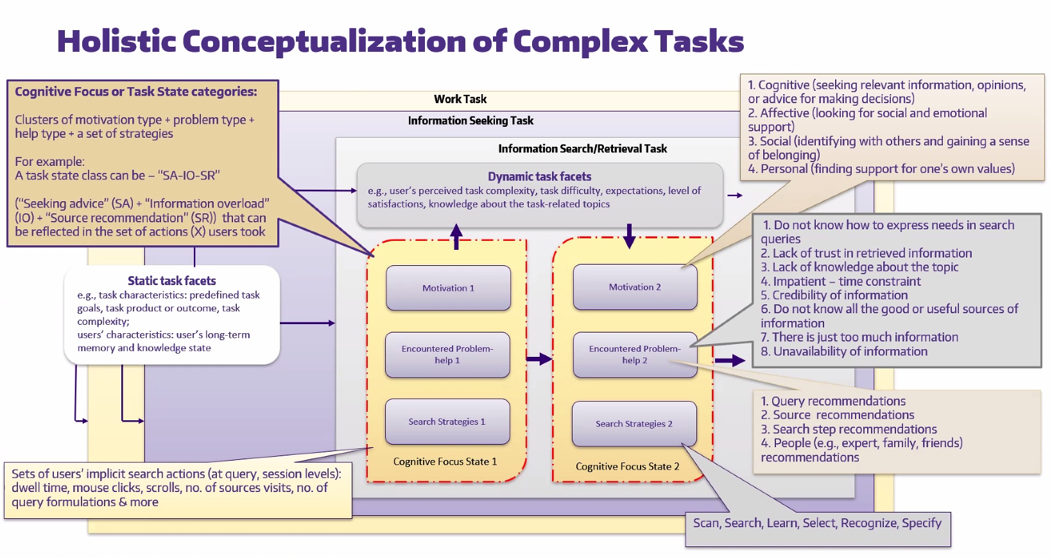
Sarkar (2023) An Integrated Model of Tasks and Uncertainties for Designing Task-aware Search Assistants. UW PhD Dissertation.

Slide 10
Tackling Complex Search Tasks
Existing support –
  Humans (e.g., librarians, subject matter experts)
  Search systems, including search engines and domain-specific search systems
Main technology progress so far: contextual search, query suggestions
New experiences: multi-device, cross-device/session, conversational search
Emerging support: generative AI, AI copilots – a focus in this keynote

Slide 11
Supporting Complex Search Tasks

Slide 12

Examples of Complex Search Task Support
Query suggestion and trail suggestion
Contextual search and personal search
Multi-device search experiences
Task decomposition support (task planning assistance)
Task continuation support (task resumption assistance)
Conversational agents
AI copilots (powered by foundation models such as GPT-4)
… and many more (recommendations, etc.)

Slide 13
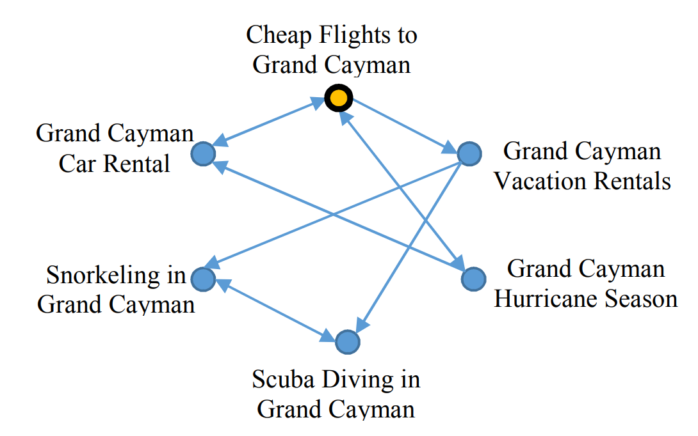
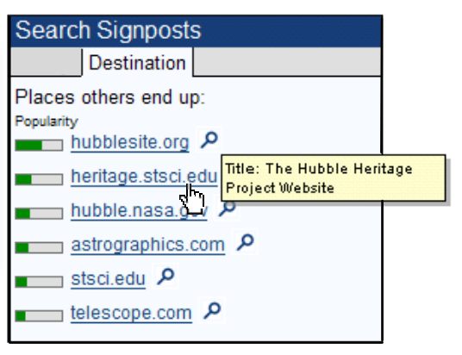

Query Suggestion and Trail Suggestion
Mining task facets from query logs¹
Mining trails from browse logs^{2,3} – suggest
full trails and/or popular trail destinations
^{1.} Awadallah, White, et al. (2014) Supporting Complex Search Tasks. CIKM.
^{2.} Singla, White, et al. (2010) Studying Trailfinding Algorithms for Enhanced Web Search. SIGIR.
^{3.} White et al. (2007) Studying the Use of Popular Destinations to Enhance Web Search Interaction. SIGIR.

Slide 14
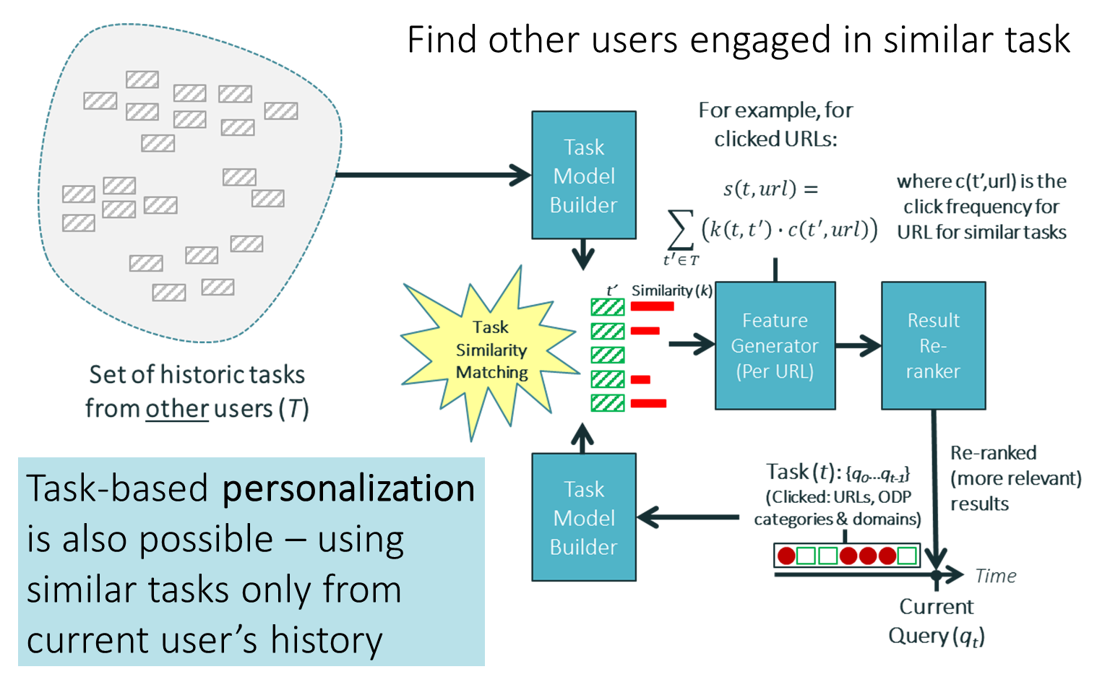
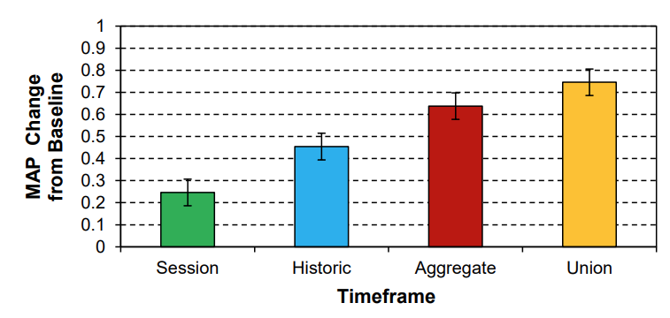
Contextual Search and Personalized Search
Contextual re-ranking via session data, location, reading level, etc.¹
  Shipped in Bing over 10 years ago, covering most query traffic
“Groupization” (cohorts)
and personalization²
Identify and model tasks
Find related tasks
Use on-task information
(Re-)rank
Personalized search performance
^{1.} Bennett, White, et al. (2012) Modeling the Impact of Short- and Long-Term Behavior on Search Personalization. SIGIR.
^{2.} White et al. (2013) Enhancing Personalized Search by Mining and Modeling Task Behavior. WWW.

Slide 15
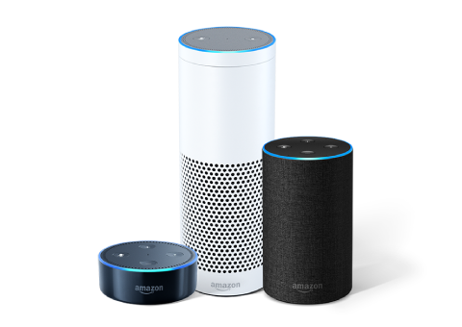



Multi-Device Experiences
Experiences spanning devices to better support complex tasks
+
Multi-modal
Cross-device
Hands-free
E.g., Cooking, home improvement, etc.
White et al. (2019) Multi-Device Digital Assistance. CACM.

Slide 16
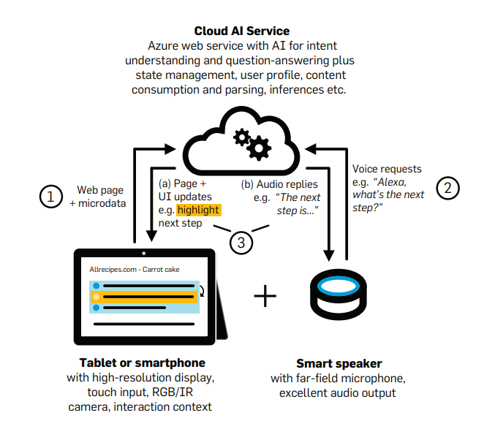
MDX Azure Service
Stepwise engagement with
websites via multiple devices
Core functionality:
  State reflection across devices
  Simultaneous readout across devices
  Website mining and step extraction
  Intent understanding
  Stepwise navigation
  Contextual Q&A
  Proactive recommendations
Basic flow:
  User visits MDX-enabled website
  Task steps are passed to service (flagged by author in HTML or auto-extracted)
  User requests next step or asks question via voice
  System responds on the screen and vocalizes through speaker
  (optional) System generates additional recommendations for current step
White et al. (2019) Multi-Device Digital Assistance. CACM.

Slide 17
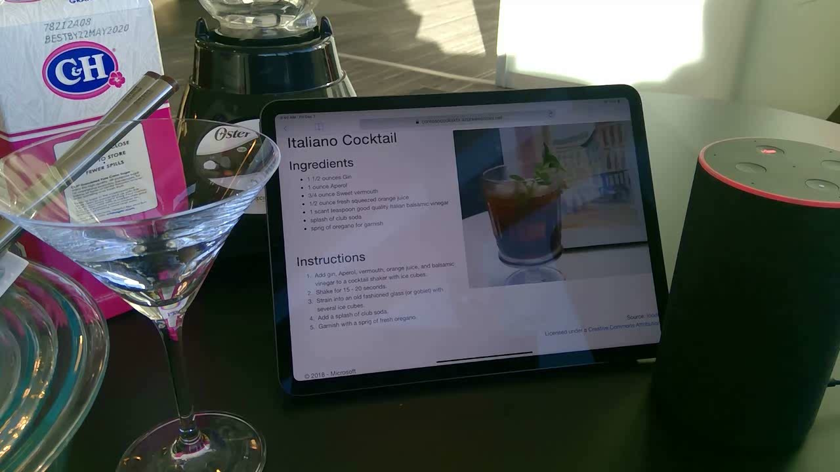
MDX - Guided Task Completion on iPad and Echo

Slide 18



Task Decomposition
From complex to-do tasks to actionable steps and dependencies
Mine related queries and instructional articles from search logs
1
Set up the time
Extract
or
Summarize the content
4
Buy food and beverages
2
Create a guest list
3
Send out invitations
Zhang, White, et al. (2021). Learning to Decompose and Organize Complex Tasks. NAACL.

Slide 19
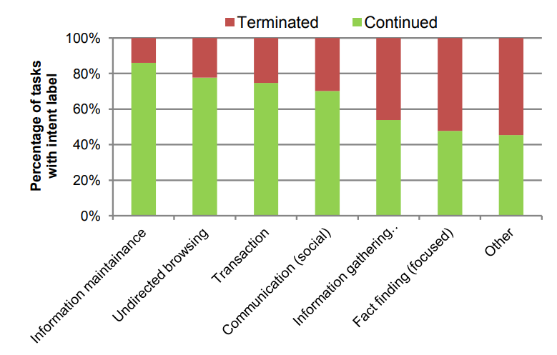
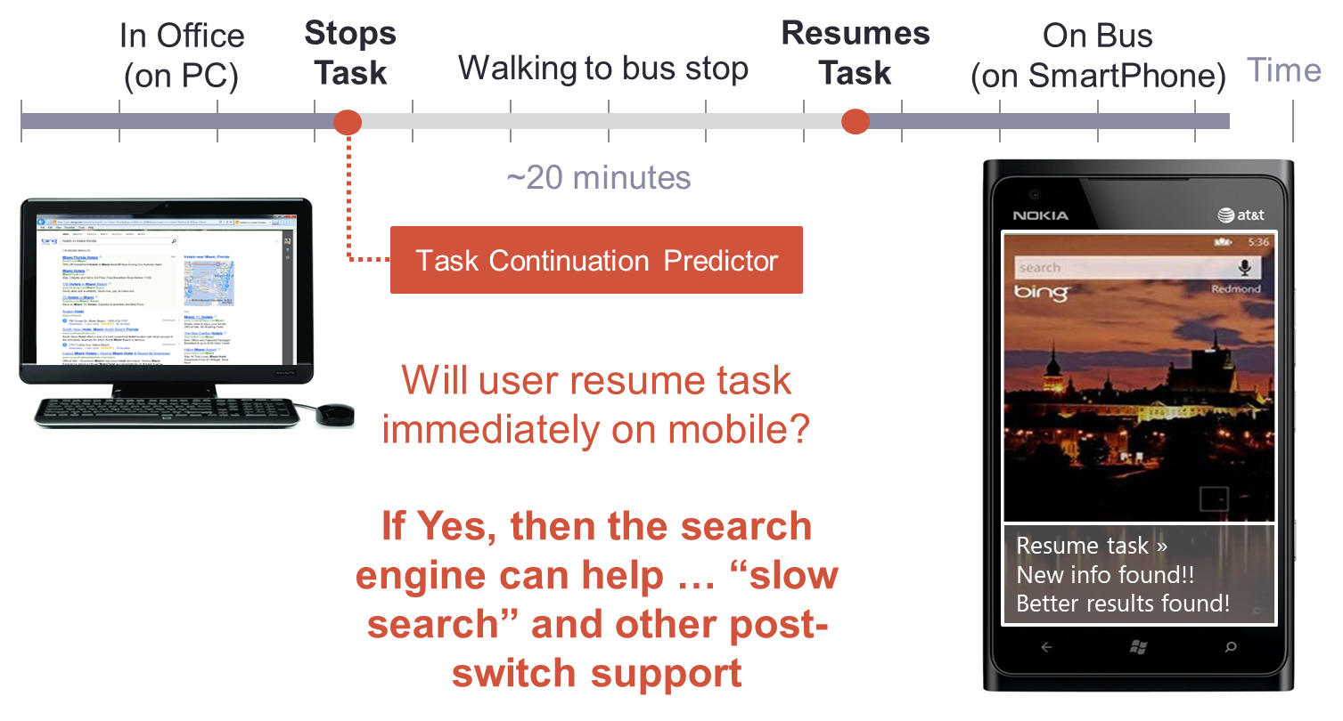
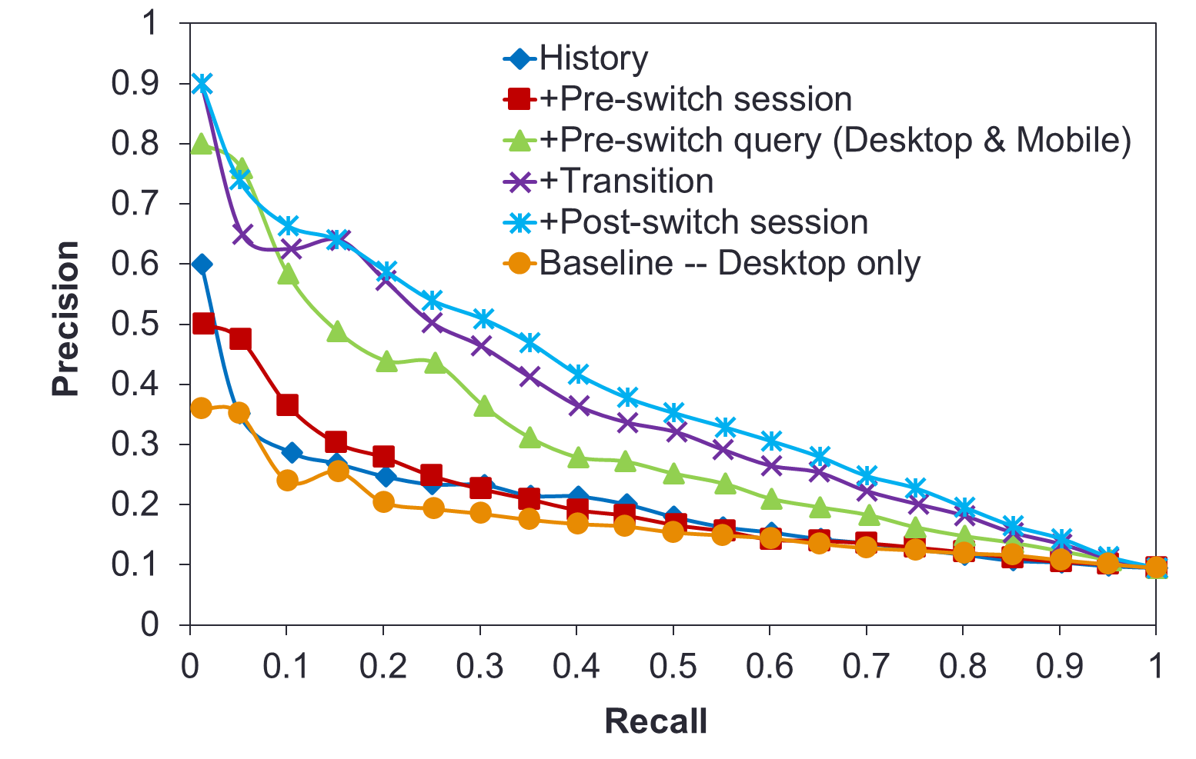
Task Continuation
Tasks persist over time and span sessions¹
Predicting task continuation across devices^{2,3}
^{1.} Agichtein, White, et al. (2012) Search, Interrupted: Understanding and Predicting Search Task Continuation. SIGIR.
^{2.} Wang, White, et al. (2013) Characterizing and Supporting Cross-Device Search Tasks. WSDM.
^{3.} Montanez, White, et al. (2014) Cross-Device Search. CIKM.

Slide 20
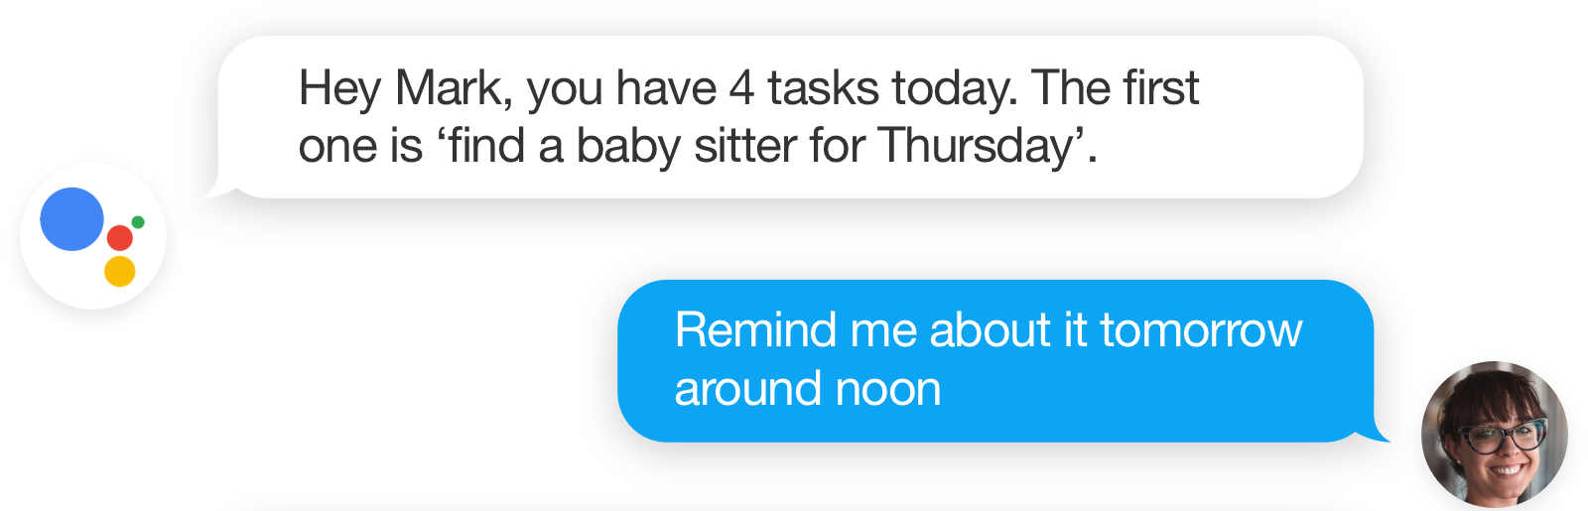
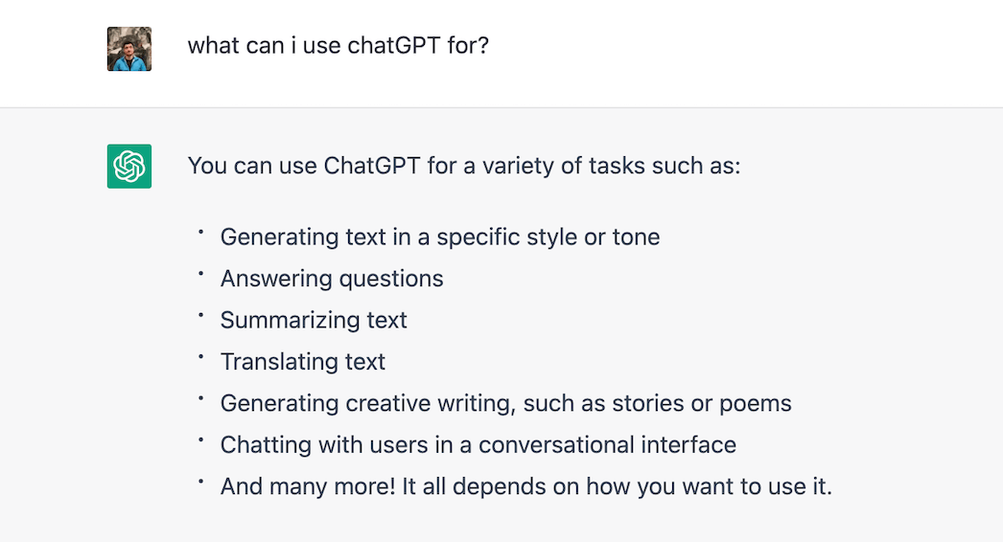
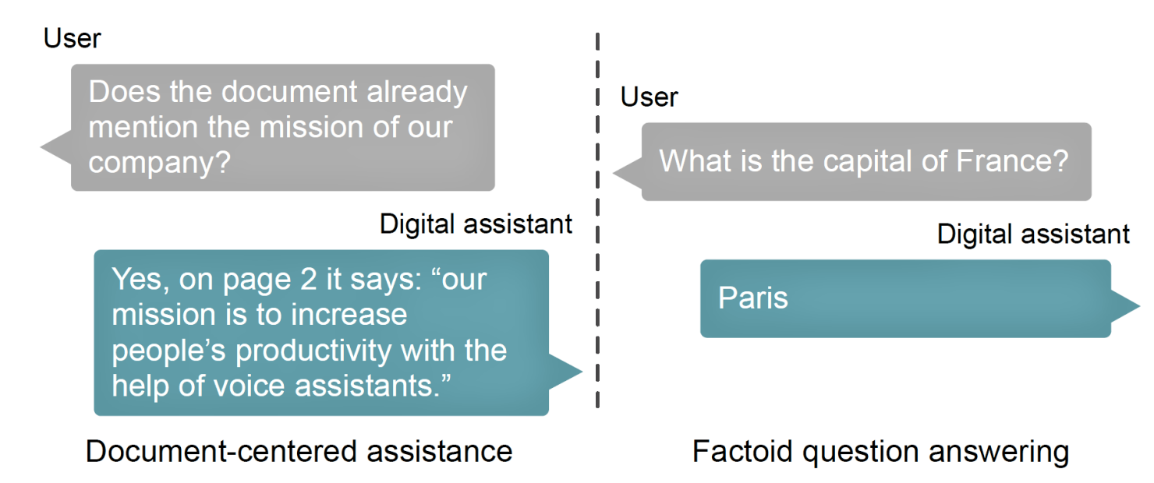
Conversational Agents
Conversational search
  Multi-turn dialogs with AI agents
  Google Assistant, Alexa, Siri, Cortana
Emerging opportunities for task support
via large-scale foundation models
  Conversational task assistance (ChatGPT)
  Document-centered assistance¹
  AI copilots in search (more on this now)
^{1.} Ter Hoeve, White, et al. (2020) Conversations with Documents: An Exploration of Document-Centered Assistance. CHIIR.

Slide 21
AI Copilots

Slide 22

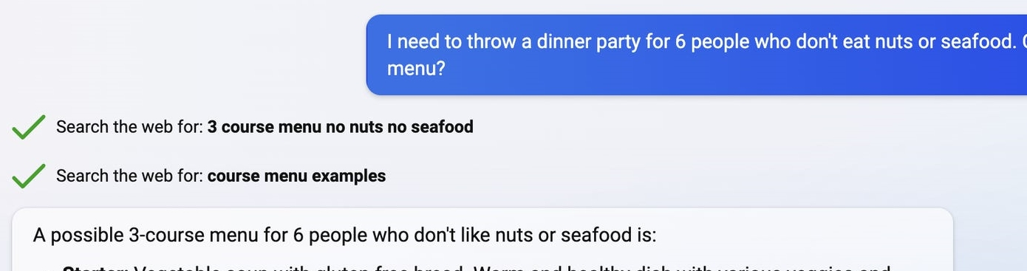
AI Copilots
Microsoft Copilot definition:
Many examples:
  GitHub Copilot – Your AI pair programmer
  Bing Chat – AI-powered answer engine
An application using modern AI to assist you with complex cognitive tasks

Slide 23
AI Copilots
Four primary characteristics of copilots:
  Conversational user interfaces – interact via natural language
  Powered by foundation models (LLMs/LMMs such as GPT-4)
  Extensible with skills/tools/plugins
  Scoped to specialized domains or applications (incl. search – Bing Chat)

Slide 24
Microsoft Copilot Stack
Copilot frontend
Plugin extensibility
UX
Orchestration
Prompt & response filtering
Metaprompt
AI
safety
Grounding
Plugin execution
Foundation models
Hosted foundation models
Hosted fine-tuned foundation models
BYO models
AI infrastructure

Slide 25
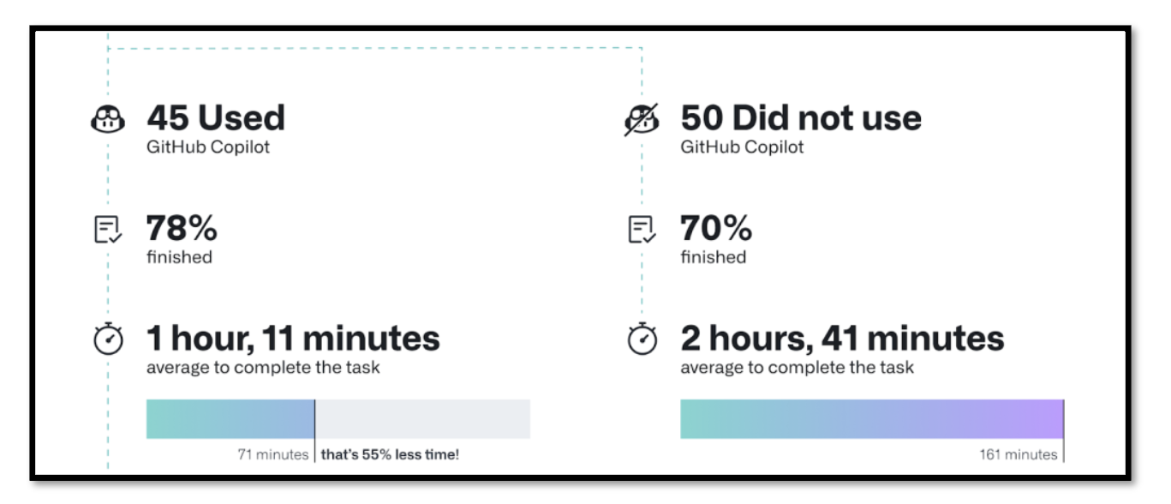
Copilots Add Value
GitHub Copilot – Assists software developers
Studies show reduced effort, more success, 2x faster task completion
Bird et al. (2022) Taking Flight with Copilot: Early Insights and Opportunities of AI-powered Pair-programming Tools. ACM Queue.

Slide 26
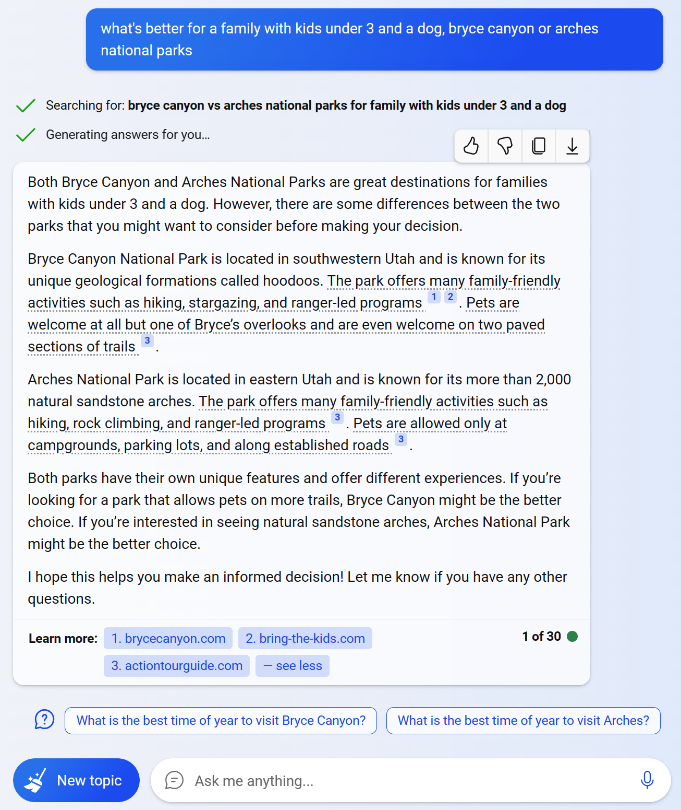
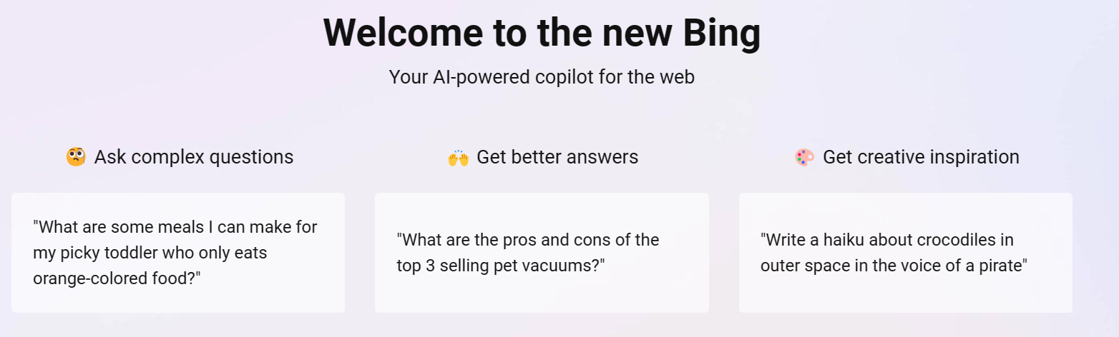
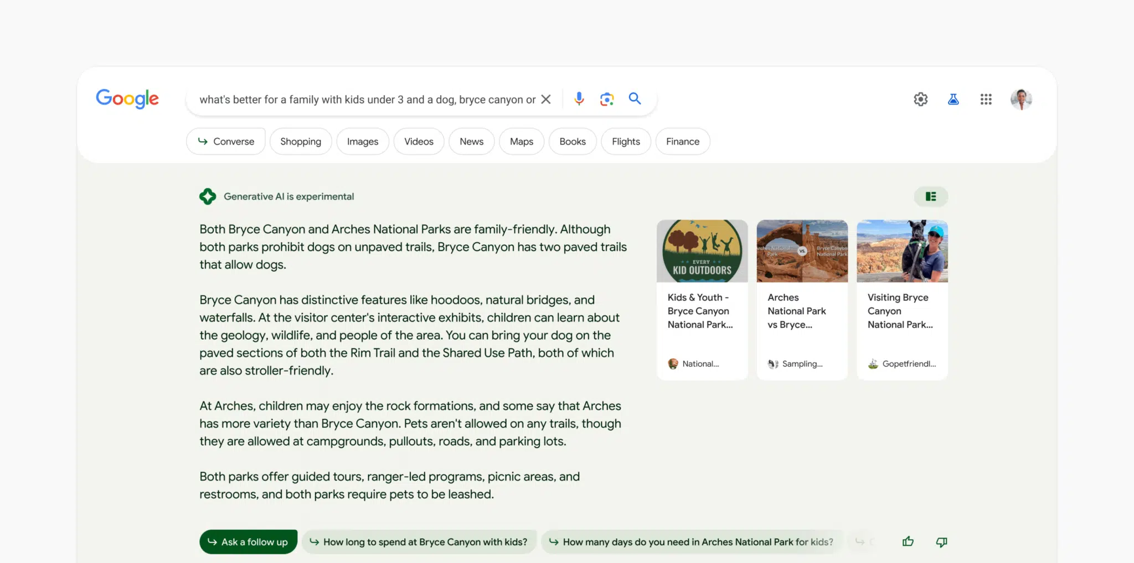
Copilots in Search
Bing Chat
Google BARD

Slide 27
Copilots Help Us Do More
Help users be more productive, efficient, and successful
Broader range of tasks than information finding
Higher-order tasks
  More focus on macrotasks, less focus on actions
New capabilities – e.g., Creative tasks
  Move us closer to all-task completion
  Insights (e.g., interview prep)
  Productivity (e.g., coding, email composition)
All task activity
Create
New frontier
with search plus copilots
Learn and
Investigate
Find
Old frontier
with search only
* Not to scale

Slide 28
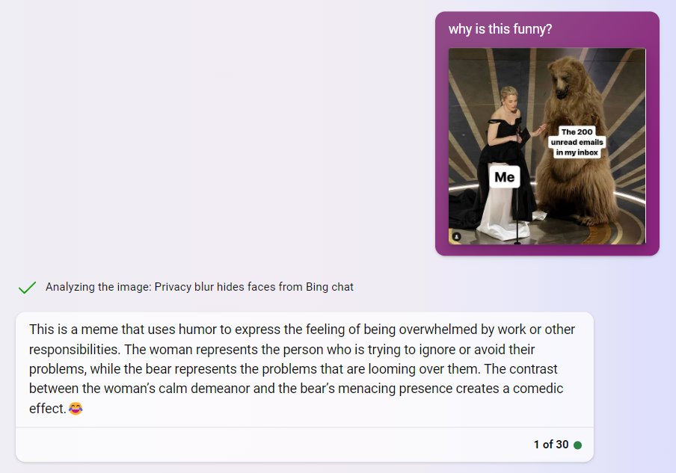
Copilot Interaction
Recent addition to search copilots (Bing Chat): Image input
Primarily natural language queries and dialog
  Also, recently, multi-modal input and output
Generate/synthesize direct answers to user questions
Can include source attribution to improve trust and accountability
Broaden the scope of scenarios possible with search engines
  Complement not a replacement to traditional search
Credit: Ethan Mollick (@emollick)

Slide 29
Search and Copilot (Bing Chat) Interaction
User
User
Bing Search
User
User
Goal
Choose a restaurant
Plan a wedding
Build software
Decompose goal into queries
Find restaurant reviews
Search available venues
Research software libraries
Retrieve relevant pages using keywords
Examine SERPs, select and read pages
Aggregate
results
Bing Search
User
User
Bing Chat
User
Goal
Choose a restaurant
Plan a wedding
Build software
Express goal in natural language
Retrieve, aggregate, and synthesize relevant knowledge into an answer
Read answer
Bing Chat
Bing Chat does several steps that users had to do themselves
Decompose goal into sub-goals or sub-queries
Examine SERPs, select and read pages
Aggregate and synthesize relevant knowledge from retrieved information

Slide 30
Challenges With AI Copilots

Slide 31
Challenges
Challenges from using copilots in search include:
  Generated answers could be wrong - hallucinations
  Synthesis from different information sources may amplify biases in data
  New/different opportunities for learning, exploration, and adaptation
  Different types of human control (no SERP interaction, richer task specification)

Slide 32
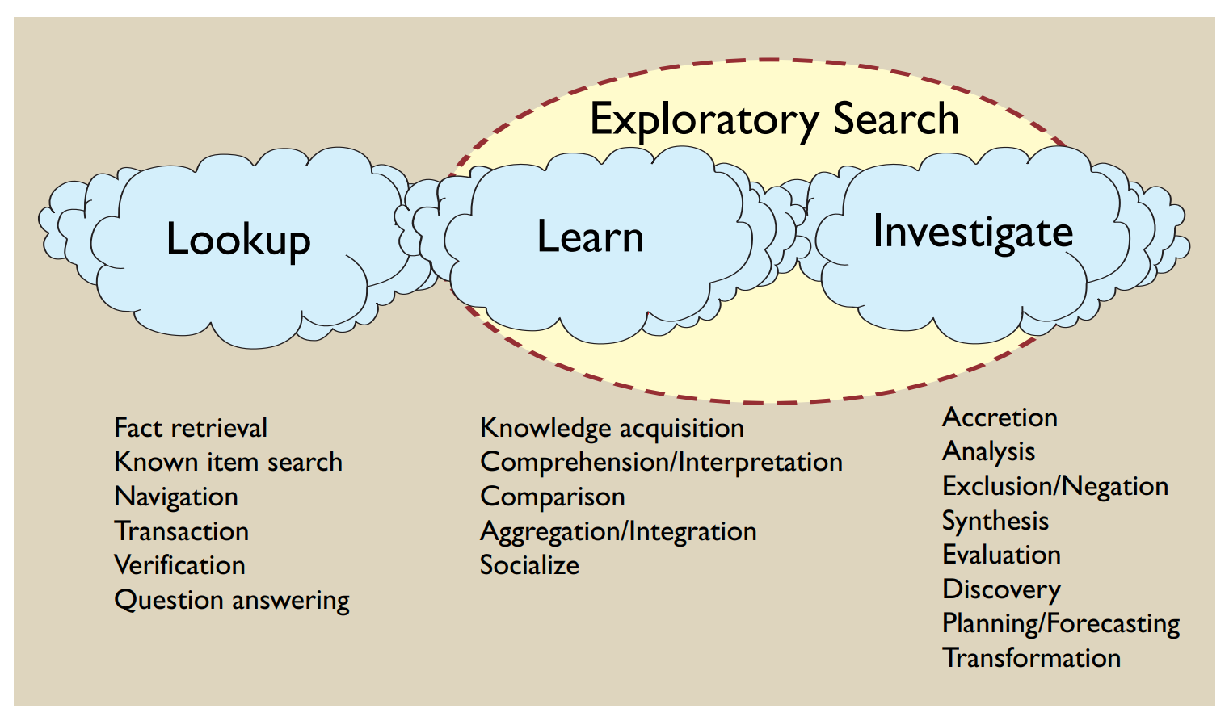
Human Learning
Exploratory search¹
  From finding to understanding
  Learning by engaging with information
Searching as a learning process^{2,3}
Both involve considerable time and effort – but also enhance learning
Copilot users can ask richer questions, receive synthesized answers
  Less need for users to formulate their own answers
  Creates new/different learning opportunities
^{1.} Marchionini (2006) Exploratory search. CACM.
^{2.} Rieh et al. (2016) Toward searching as learning process. JIS.
^{3.} Vakkari (2017) Searching as learning. JIS.

Slide 33
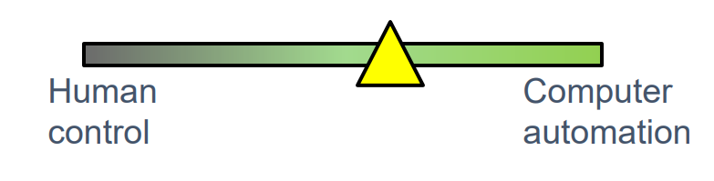
Human Control
System Involvement by Search Activity¹
Search Activity
Level
Searchers want control over search process¹
  Know what info is/not being included and why
  Important in building trust in system output
Copilot users delegate control of answers
Rest is mixed:
  Less control of search mechanics (queries, etc.)
  More control of task specifications (NL, dialog)
Automation versus control too simplistic - not zero sum²
  Need to ensure human control while increasing automation
System
Involvement Level
Moves
Tactics
Strategems
Strategies
No system involvement
Display possible activities
Search Engines
Search Engines
Copilots
Executes actions on command
More automation
Monitors search and recommends
Proactive experiences – need careful interaction design
Executes automatically
Total automation – unlikely (need human control)
More strategic, higher-order actions
^{1.} Bates (1990) Where should the person stop and the information search interface start? IP&M.
^{2.} Shneiderman (2022) Human-Centered AI.

Slide 34
Human Control
System Involvement by Search Activity
Just For Reference (and Fun!)
Status and Recommendations Per Bates, circa 1990
Search Engines and AI Copilots
Search Activity
Level
Search Activity
Level
System
Involvement Level
Moves
Tactics
Strategems
Strategies
System
Involvement Level
Moves
Tactics
Strategems
Strategies
No system involvement
No system involvement
Search activities carried out by searcher
Display possible activities
Search Engines
Display possible activities
Most operational IR systems now
Area of recommended development
Hold for later
Search Engines
Copilots
Executes actions on command
Executes actions on command
More automation
Monitors search and recommends
Monitors search and recommends
Bypass
Proactive experiences – need careful interaction design
Executes automatically
Total automation – unlikely (need human control)
Executes automatically
Hold for later
Common current objective for IR experimental design
More strategic, higher-order actions
Bates (1990) Where should the person stop and the information search interface start? IP&M.

Slide 35
Adding Copilots to Search Engines

Slide 36
Copilot Deployment
Not practical or necessary to deploy copilots for all search tasks
Foundation model inference is expensive at massive scale
Can focus copilots on complex search tasks, with highest searcher utility
Also -
  Conversational interfaces less familiar for users in a search context (needs time)
  Traditional search already excels for many types of task (navigation, fact-finding)

Slide 37


Solution - Better Together
Unifying search and copilots
  E.g., Bing Search, Bing Chat
Experiences that unify search and chat will be more common
Users can select modality based on task and personal preferences
Other aspects, such as conversation style/tone, are also controllable
Bing
Search
Bing
Chat
+

Slide 38
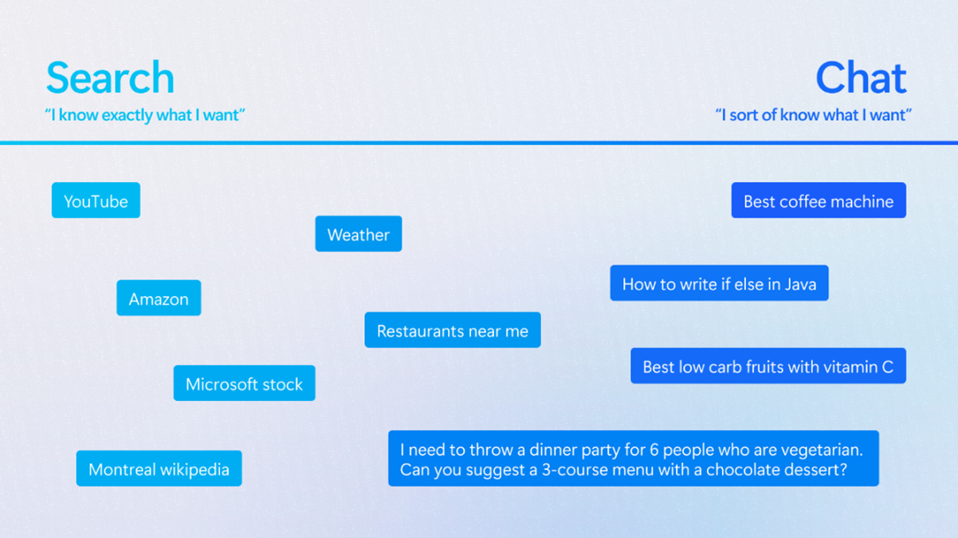
Unifying Search and Chat

Slide 39
Bing Chat
Uses retrieval augmented generation for grounding
  No need to retrain massive foundation model (GPT-4) over time
  Results provide relevant and fresh information to foundation model
  Provides a provenance signal linking generated content with sources
Foundation model generates internal queries iteratively
Foundation model generates answer given this grounding
Pulls in relevant Bing search answers such as weather, stock, sports, etc.

Slide 40
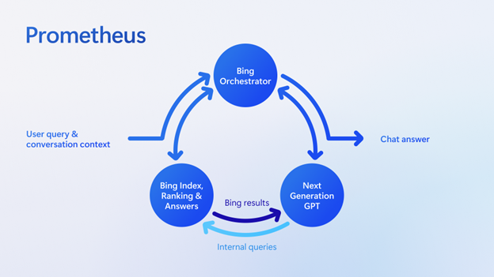
Bing Chat – Answer Engine

Slide 41
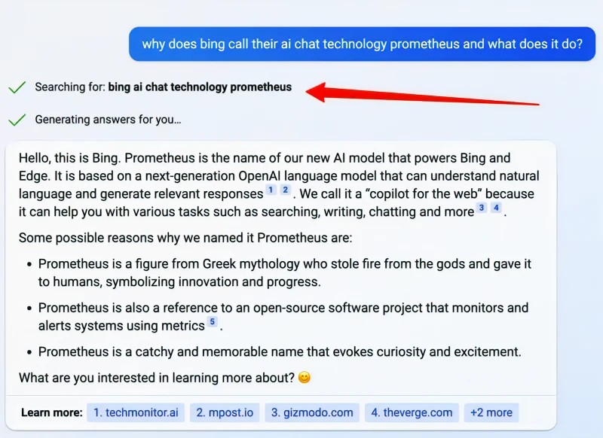
Search Results as Grounding
Auto-generated queries from user NL request
Note: Could be several queries if needed
“Show the work” behind foundation model generated outputs
Note: Showing queries and citations helps builds trust

Slide 42
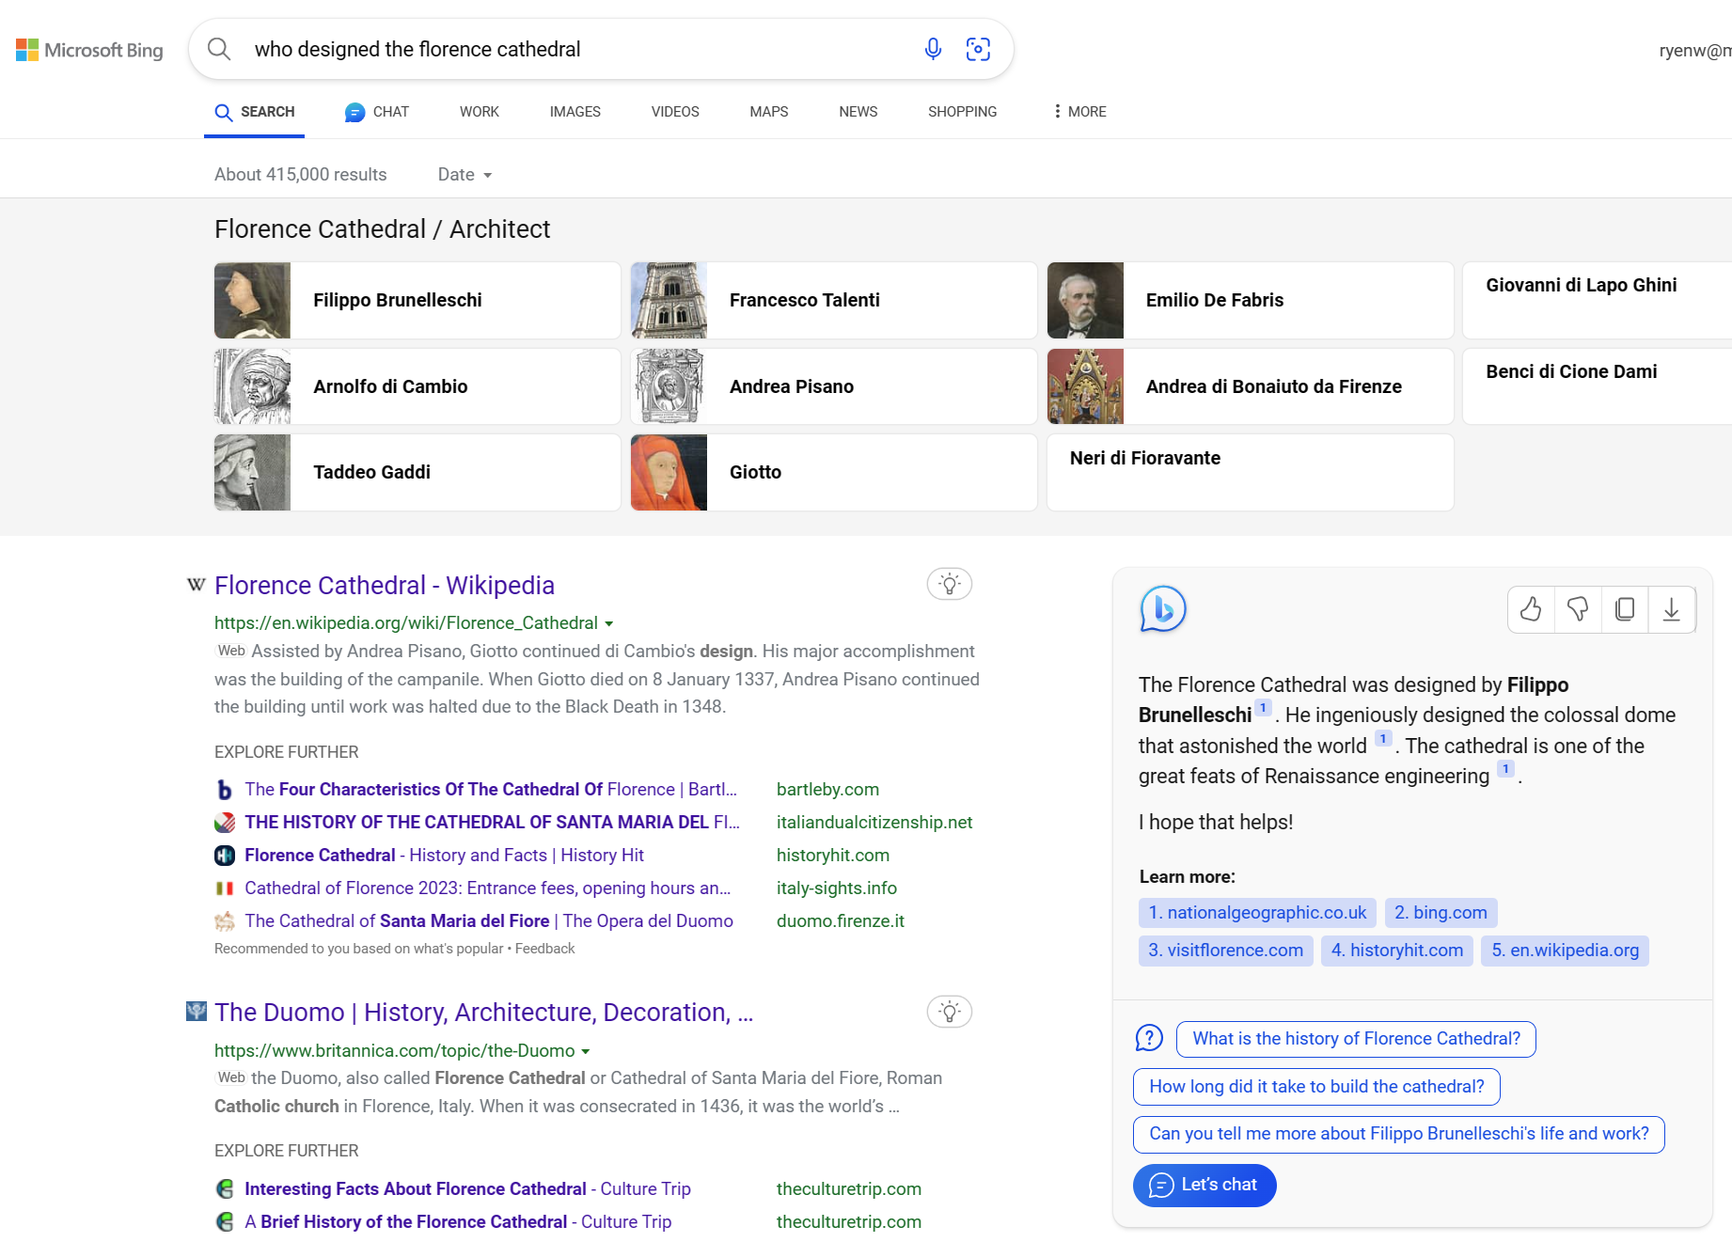
Copilots Enable Dynamic Answers on SERPs
Chat answer
shown inline on SERP

Slide 43
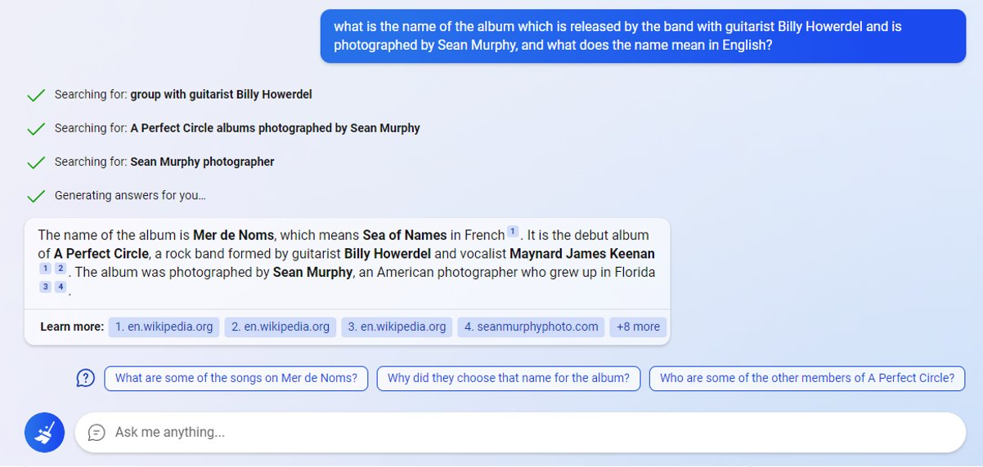
Copilots Help Tackle Complex Search Tasks
Using search alone would require more user effort
Different perspectives on task complexity, e.g.,
 |  | User
 |  | Low | High
System | Low | Find | Create
 | High | Verify | Analyze

Slide 44
(Some) Copilot Opportunities for the IR Community
A Personal Perspective

Slide 45
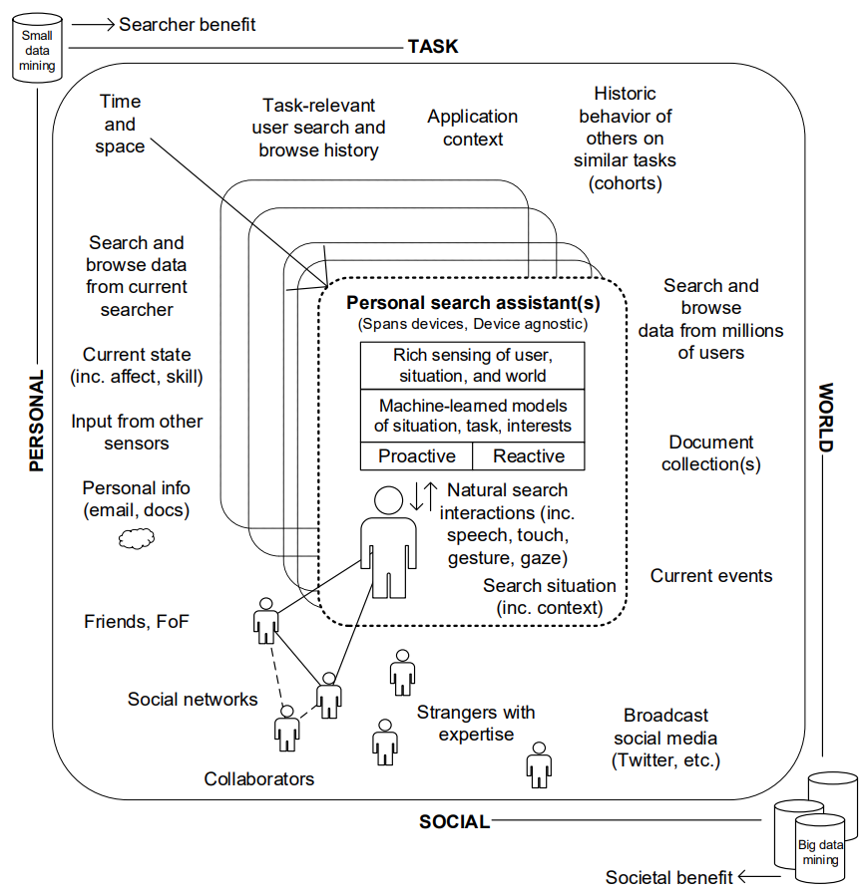
North Star
Personal search assistants
with advanced capabilities
  User/task/world models
  Rich sensing
  Natural language interactions
  Reactive and proactive
Search + Copilots is a step
toward this vision
White (2016) Interactions with Search Systems.

Slide 46
(Some) Opportunities for the IR Community
Traditional Search
+
Search Copilots
Model Innovation
Task Modeling
Next-Generation Experiences
Search + Chat
Measurement
Understanding
Broader Implications
Alignment
Augmentation
Grounding
Personalization
Control
Completion
Evaluation
Responsibility
Economics
Ubiquity
Learning
… and likely many more

Slide 47
Model Innovation

Slide 48
Task Modeling
Opportunity: Build richer task models that more fully represent tasks and task contexts
How do we infer tasks?
  From textual content of search process
  From user-system interactions at session/query/dialog levels
  From other situational and contextual information such as location, time, device
How should we represent tasks?
  Tree extraction, Abstract representation (vectors, graph embeddings, Markov models, …)
  Estimating key task characteristics, e.g., task complexity → search or chat
More user/world knowledge helps copilots better support complex tasks

Slide 49
Alignment
Opportunity: Develop methods to continuously align copilots to tasks/goals/values via feedback
Create application-aligned feedback loops
  Better understand searcher goals and tasks
  Improve answer accuracy and relevance over time
Align copilots to tasks/goals/values
  E.g., Conversations as feedback, Explicit feedback
Relevant research on implicit feedback in IR
  Learning directly from SERP clicks¹
  Specialized interfaces to capture user feedback²
Copilots with alignment
Searcher Value
Copilots out-of-the-box
Time
^{1.} Joachims (2002) Optimizing Search Engines Using Clickthrough Data. SIGKDD.
^{2.} White et al. (2005) Study of Factors Affecting the Utility of Implicit Relevance Feedback. SIGIR.

Slide 50
Augmentation
Opportunity: Augment copilots with relevant external knowledge and enhanced tools/capabilities
Improve relevance in retrieval augmentation w.r.t. copilot consumption
  Relevance models tuned to maximize user benefit, not for foundation models
Address copilot shortcomings (and complete tasks) via skills/plugins
  Find and recommend skills per task demands¹, e.g., Wolfram
  Use tool-augmented models, e.g., Toolformer²
Better ground copilot responses via context
  E.g., Richer sensing, Context filtering, Dynamic prompts
  ^{1.} White (2018) Skill Discovery in Virtual Assistants. CACM.
  ^{2.} Schick et al. (2023) Toolformer: Language Models Can Teach Themselves to Use Tools.

Slide 51
Grounding
Opportunity: Use grounding to reduce hallucinations, build user trust, and support content creators
Provenance – Provide links back to relevant sources
  Builds user trust in answers. Provides attribution for content creators
  Links should be relevant and contain precise details not generalities
Faithful reasoning
  Provide copilot answers that are transparent
    Step-by-step reasoning, explanations with chain-of-thought, etc.
    Important to support user learning
Integrate search with existing experiences (e.g., in other copilots)
  Ground answers in more places people seek them

Slide 52
Personal Copilots
Opportunity: Develop personal copilots that understand users/tasks, using personal data, privately
Study foundation model capabilities
  Identify task-relevant information in personal data
  Model user knowledge in current task and topic
Develop core technologies
  Infinite memory – Use relevant long-term activity (in IR: re-finding¹, personalization²)
  Context compression – Fit more context into finite token limits
  Privacy – Mitigations (DP/FL) are essential, as is research on machine unlearning
  Example personal prompts:
  Write an e-mail to my client in my personal style with a description of the quote in the attached doc.
  Where should I go for lunch today?
  Tell me what’s important for me to know about the company town hall that I missed?
^{1.} Tyler and Teevan (2010) Large-scale Query Log Analysis of Re-finding. WSDM.
^{2.} Teevan et al. (2005) Personalizing Search via Automated Analysis of Interests and Activities. SIGIR.

Slide 53
Next-Generation Experiences

Slide 54
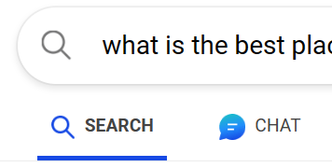
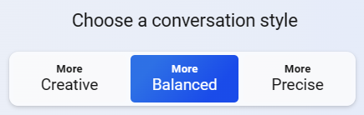
Unified (Search + Chat) Experiences
Opportunity: Develop experiences bridging search and chat, offering explanations and suggestions
More seamless experiences spanning two modalities
Explanations on what each modality and style are good for
Modality recommendation given task
  Simple tasks need search, Complex tasks need copilots
Conversation style recommendation given task
  Fact-finding task or short reply → precision
  Generating new insights/content → creativity

Slide 55
Human Learning
Opportunity: Develop copilots that can detect learning tasks and support relevant learning activities
Auto-detect critical learning and sensemaking tasks
Develop copilot experiences that provide:
  Detailed explanations and reasoning
  Links to learning resources (e.g., videos)
  Deep engagement with task content (e.g., via queries or relevant sources)
  Support for specifying and attaining learning objectives

Slide 56
Human Control
Opportunity: Better understand control & develop copilots with control while growing automation
Experiences that provide users with more agency, e.g.,
  Adjust specificity/diversity in answers → less general, less repetition
  Verify citation correctness
User studies to understand implications of
  Less control of some aspects (e.g., answer generation)
  More control over other aspects (e.g., macrotask specification)
  Control over new aspects, such as conversation style/tone

Slide 57
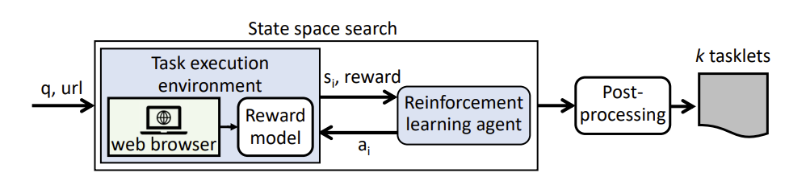
Completion
All task activity
Create
Expand the task frontier
Opportunity: Copilots help complete tasks, keep users in control
Learn and
Investigate
Copilot users better complete more tasks
  Plugins as actuators of digital world
  Start simple (e.g., bookings), increase complexity
Copilots can take initiative, with permission
  Updates (standing tasks), Proactive suggestions
  Help support task planning, e.g., travel, events
AI can already help complete repetitive tasks
  Action Transformers – Trained on digital tools
  Learning “tasklets” (UI scripts) from websites¹
Find
Deepen task
capabilities
^{1.} Li and Riva (2021) Glider: A Reinforcement Learning Approach to Extract UI Scripts from Websites. SIGIR.

Slide 58
Measurement

Slide 59
Evaluation
Opportunity: Identify/develop metrics for copilot evaluation, while considering important factors
Copilot metrics
  Many options – feedback, engagement, PR, F1, generation quality, accuracy, etc.
  Focus on task (success, effort, SAT/DSAT, etc.) not only turn-by-turn metrics
Important to consider
  Repeatability – Non-determinism can make copilots difficult to evaluate/debug
  Interplay between search and copilots (switching, joint task success, etc.)
  Longer term effects on user capabilities and productivity
  Task characteristics – Complexity, etc.
  New benchmarks – Copilots affected by external data, grounding, queries, etc.

Slide 60
Understanding
Opportunity: Deeply understand copilot capabilities and copilot impact on users and on their tasks
User understanding
  Mental models of copilots, Effects of bias (functional fixedness)
  Changes in search behavior (ISSs, etc.) – Search versus chat, search and chat
  Understanding search interactions – Log analysis, user studies¹
  LLMs to analyze logs, generate intent taxonomies, classify intents, etc.
Task understanding
  Copilot usage in tandem with regular search
  Intents and tasks are copilots being used for and most effective for
Copilot understanding – Capabilities and limitations
  E.g., “Sparks of AGI” paper on GPT-4²
^{1.} Capra and Arguello (2023) How Does AI Chat Change Search Behaviors?
^{2.} Bubeck et al. (2023) Sparks of Artificial General Intelligence: Early experiments with GPT-4.

Slide 61
Evaluation
Human-LLM collaboration variations
for relevance judgments in IR¹
Human-LLM collaboration variations
for relevance judgments in IR¹
Opportunity: Applications of copilot components for IR evaluation
Collaboration Integration |  | Task Organization
Human Judgment
 | The human will do all judgments manually without any kind of support. | The human will do all judgments manually without any kind of support.
 | Humans have full control of judging but are supported by text highlighting, document clustering, etc. | Humans have full control of judging but are supported by text highlighting, document clustering, etc.
AI Assistance
 | The human assessor judges an LLM-generated summary of the document. | The human assessor judges an LLM-generated summary of the document.
 | Balanced competence partitioning. Humans and LLMs focus on tasks they are good at. | Balanced competence partitioning. Humans and LLMs focus on tasks they are good at.
Human Verification
 | Two LLMs each generate a judgment, and a human selects the better one. | Two LLMs each generate a judgment, and a human selects the better one.
 | An LLM produces a judgment (and an explanation) that a human can accept/reject. | An LLM produces a judgment (and an explanation) that a human can accept/reject.
 | LLMs are considered crowdworkers, varied by specific characteristics, and controlled by human. | LLMs are considered crowdworkers, varied by specific characteristics, and controlled by human.
Fully Automated
 | Fully automatic assessment. | Fully automatic assessment.
Foundation models for relevance judgments
  AI assistance, not AI automation¹
  Can generate explanations for judges
… and powerful searcher simulations
  Better mimic human behavior and values
  Expand early work on searcher simulations in IR²
AI
AI
AI
AI
AI
AI
AI
AI
∙n
AI
^{1.} Faggioli et al. (2023) Perspectives on Large Language Models for Relevance Judgment. ICTIR.
^{2.} White et al. (2005) Evaluating Implicit Feedback Models Using Searcher Simulations. TOIS.

Slide 62
Broader Implications

Slide 63
Responsibility
Opportunity: Understand factors affecting reliability, safety, fairness, and inclusion in copilot usage
Understand and improve answer accuracy (better grounding)
Understand biases in foundation models, prompts, data for grounding
Understand how well copilots work in different contexts/tasks/people
Red-teaming, user testing, and feedback loops to learn emerging risks
Build on work on Responsible AI and IR, FACTS-IR, etc.

Slide 64
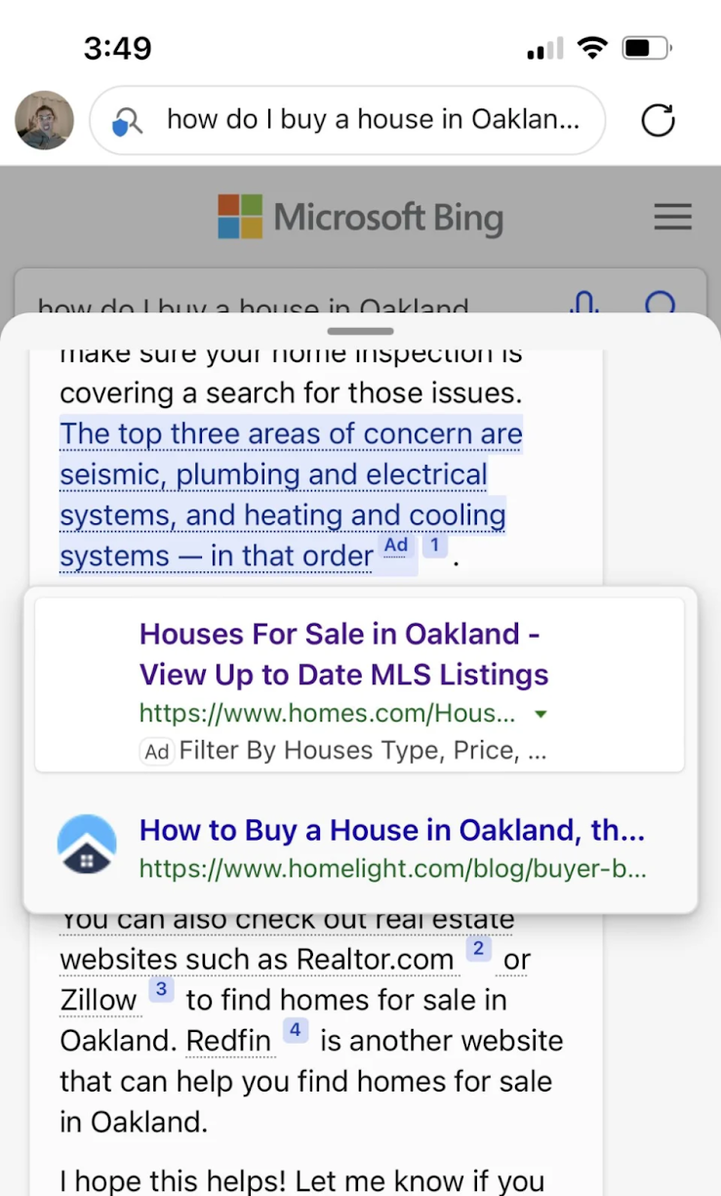
Economics
Opportunity: Understand and expand the economic impact of copilots
Explore new business models
  Copilots enable opportunities beyond information finding
  E.g., Expanding task frontier creates new business opportunity
Explore new forms of advertising
  E.g., Inline with dialog/answers, relevant to conversation
Study impact for content creators and SEO
  Content attribution vital
  Paradox of reuse¹ – lower visits, less content, worse models
Consider cost-benefit tradeoffs
  Large model inference expensive, unnecessary for many apps
  Cost will reduce with optimization
    Model specialization and Adaptive computation can help
^{1.} Vincent (2022) The Paradox of Reuse, Language Models Edition.

Slide 65
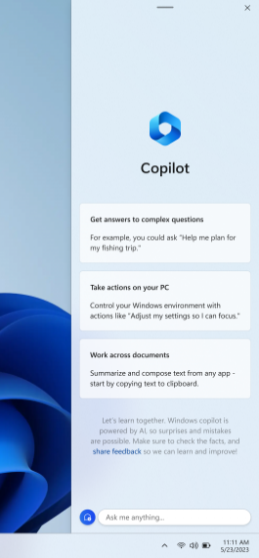
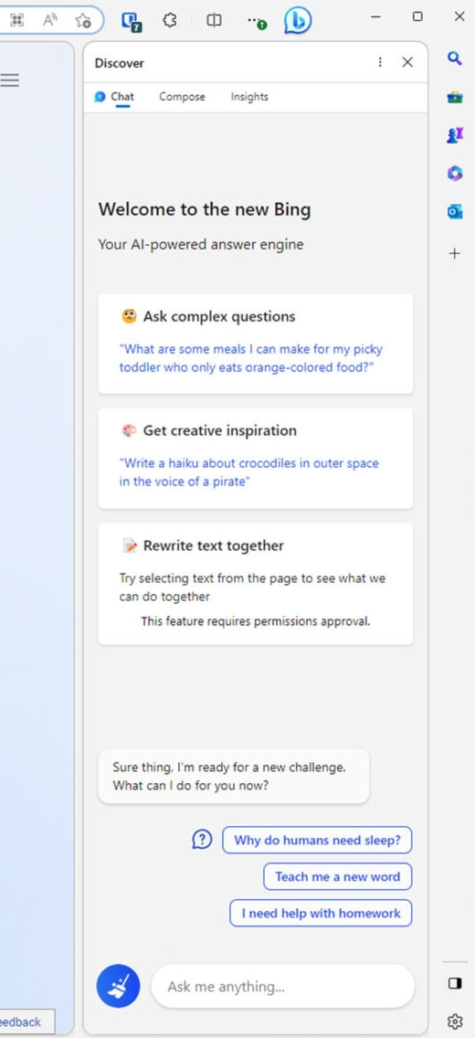
Ubiquity
Windows Copilot
Bing Chat in Edge
Opportunity: Copilot integrations to model and support complex tasks
Integration in applications, e.g.,
  Edge – In-browser chat, editing assistance, summarization
  Office – Creating Word docs, Email, PowerPoint slides, etc.
Across surfaces - Cross-app data (privately, securely)
  Windows Copilot – Direct integration with OS
Enables richer task modeling, complex task support

Slide 66
Closing

Slide 67
Closing
Tasks are central to search
Users often need help with complex tasks in particular
Already some limited complex task support
Copilots are another supporting technology – using generative AI
IR community should lean into the many opportunities here

Slide 68
Closing
Copilots will transform how we search
Need to utilize copilots plus traditional search (best of both worlds)
  Help searchers with broader range of search tasks
“Better together” experiences combining copilots with traditional search
  Need to make the joint experience more seamless
  Add more support, e.g., recommend best modality for current task or task stage

Slide 69
Closing
Copilots expanding task frontier toward completion for more tasks
Task completion is “last mile” in search interaction
  Outcomes include content creation, learning, transactions, and much more
Continued focus on human AI teaming for task completion
  Keep users in control – while increasing automation (via foundation models, skills)
  Integrate copilots with and enhance existing task workflows – e.g., app integrations
  Develop copilot support for both individual tasks and team tasks

Slide 70
Thank You.
Questions?

Slide 71
Appendices

Slide 72
Build Your Own Copilots
Plenty of resources available, e.g.,
Microsoft outlines framework for building AI apps and copilots; expands AI plugin ecosystem
Build next-generation, AI-powered applications on Microsoft Azure | Azure Blog | Microsoft Azure

Slide 73
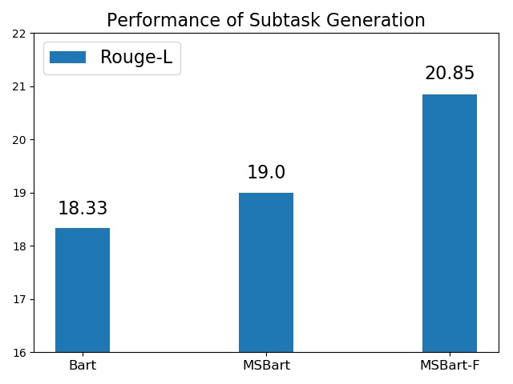
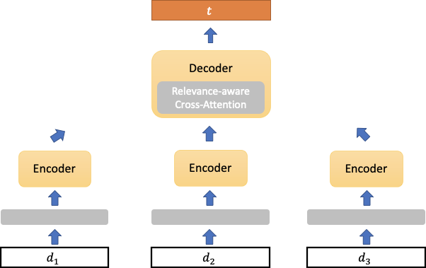
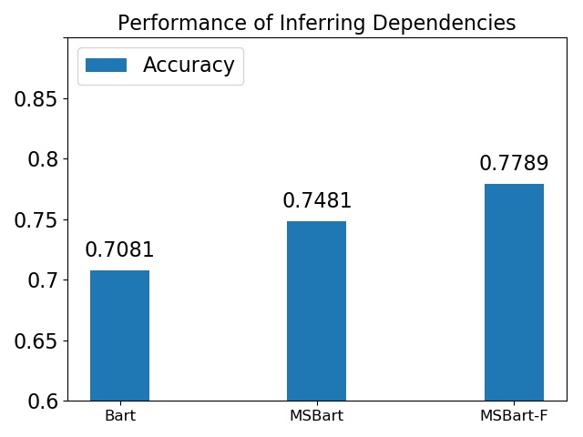

Task Decomposition
Extends BART (seq-to-seq summarizer) to handle multiple documents
Generate sub-tasks from complex task and collection of relevant docs
Create and release a dataset of complex tasks and dependencies
Model Output:
Select a date. Create a guest list. Prepare food and beverages. ...
Position Encoding:
For each token, map position id → real number
Cluster Encoding:
For each token, map sentence’s cluster id → real number
Sub-task Generation
Planning a birthday party can be a very exciting task. You are focused on ...
Celebrating one’s birthday is a special event that’s meant to be shared with loved ones ...
Sit down with your child and choose a party theme. Begin brainstorming how to incorporate ...
Relevant articles

Slide 74
Adaptation
Opportunity: Develop specialized foundation models for search tasks that are controllable/efficient
Large foundation models have a wide capability surface
Specializing discards useless knowledge - improves accuracy/efficiency
Recent advances have strong performance
  e.g., Orca-13B - explanation-based tuning¹
Explore guiding specialization via search data
  Search logs, how-to pages, videos, etc.
BigBench-Hard (zero-shot, MCQ)
60
49.7
48.9
50
40
23.3
Aggregate Accuracy (%)
30
20
10
0
Vicuna-13B
ChatGPT
Orca-13B
^{1.} Mukherjee et al. (2023) Orca: Progressive Learning from Complex Explanation Traces of GPT-4.

Slide 75
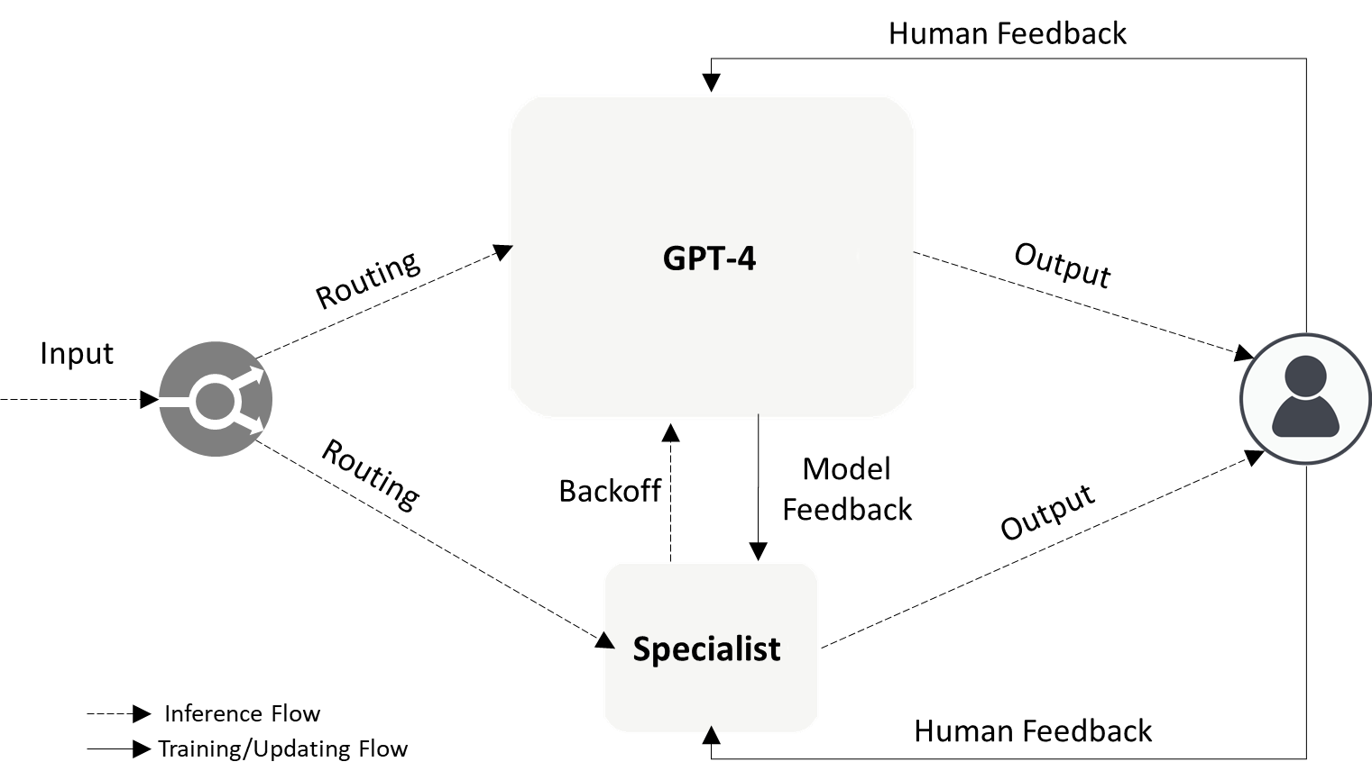
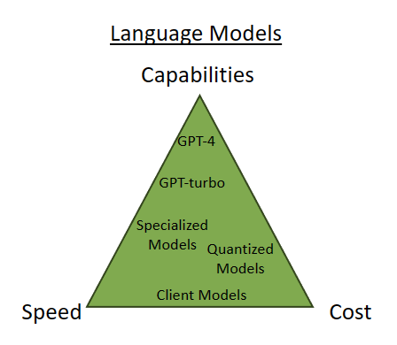
Adaptation - Adaptive Compute
Opportunity: Develop methods to adaptively apply different models per task/application demands
Adaptive computation
  Multiple foundation models with different constraints
  Learn which model to query for given task
Input can be task + constraints

